Slide 1

Feature Engineering

Slide 2
TODO (for next year)
Explain that we want the distribution to be “nice”, close to N(0,I): no fat tails, no outliers, low skewness, mostly covering [-3,3]
Explain what the logarithm is. Give an example: log(10), log(100), log(1000) differ by the same amount. Use base 10 logarithms?
Confusion between E/P and P/E (in the slides and the exercise)
The “retail” and “marketing” examples are the same: only keep one.
The “text features” exercise is really too difficult. Give more indications? Split it in several exercises? Find something else?
Put a “programming” example in the slides:
Check the data: it is a list
Before writing the loop, look at the first element of the list, and write code to process it
Put the code in a function
Call the function in a list comprehension
Check what the “Winnie clusters” are. Give examples of the sentences in question? Use Plotly? Ask an LLM to label the clusters?
When transforming the variables, no not overwrite them!
Missing values code: put the missingness indicator last
There was no time to cover data augmentation
The slides for qualitative variables are a bit confusing: review/simplify them? Add a summary slide?

Slide 3
Feature Engineering

Slide 4
Agenda
Examples
Computing features
Selecting features

Slide 5
Agenda
Examples
Finance
Retail, marketing
Images
Text
Computing features
Quantitative variables
Transformations
Missing values
Data augmentation
Qualitative variables
Dimension reduction
Time series
Joins
Text
Images
Selecting features
Constant features
Redundant features
Useful features
Useful sets of features
Multiprocessing

Slide 6
Machine Learning (ML)
X
y
input
(raw data)
output
(prediction)

Slide 7
ML: Regression
Houses
Prices
Area zip code # rooms age …
price

Slide 8

ML: Classification
Images
Labels
“cat”

Slide 9
Feature Engineering
Feature: numeric representation of the data
Feature engineering: creating and selecting features
Applications:
Better models (noise in, noise out)
Visualization
Interpretability

Slide 10
Feature Engineering
Raw data
Useful data
Prediction
Complex, large, irrelevant, noisy,
problematic,
Numeric, small, useful, non-redundant, clean, well-behaved

Slide 11
Feature Engineering
Raw data
today
Useful data
Prediction
Complex, large, irrelevant, noisy,
problematic,
Numeric, small, useful, non-redundant, clean, well-behaved

Slide 12
Deep Learning
Deep learning claims to do the feature engineering for you
Deep learning is a tool to create features, but it is not the only one

Slide 13
Examples

Slide 14
Examples
Finance
Retail
Marketing
Images
Text

Slide 15
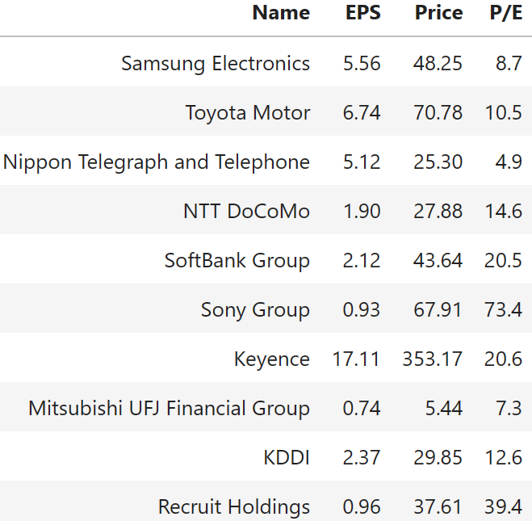
Finance

Slide 16
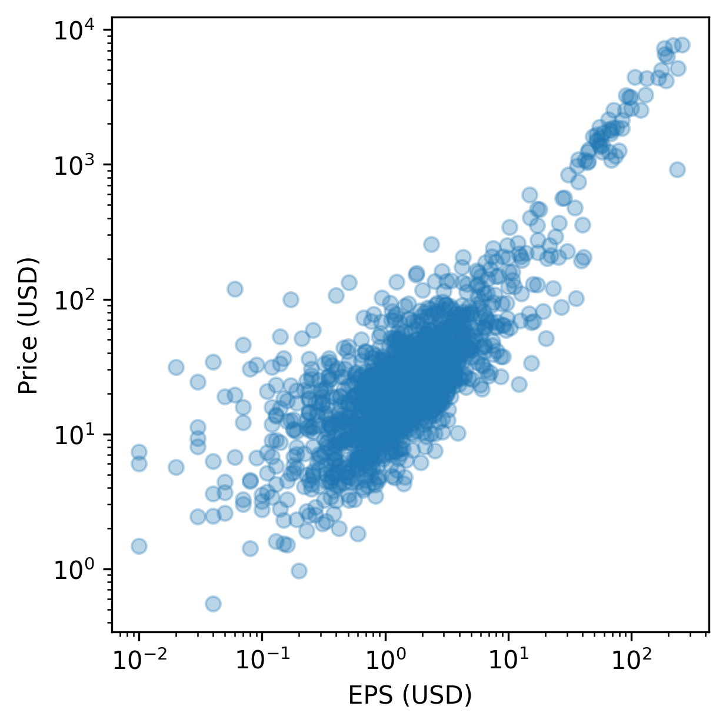
Finance

Slide 17
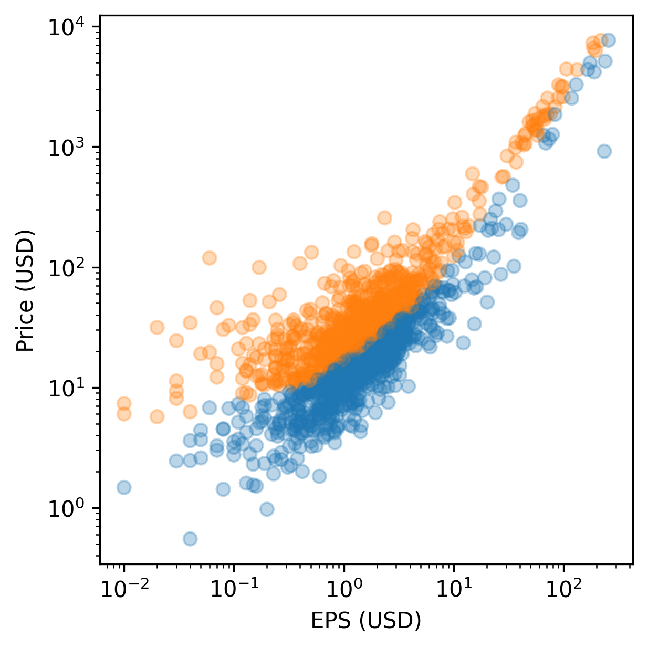
Finance
expensive
cheap

Slide 18
Finance
Financial ratios: E/P, etc.

Slide 19
Finance
Financial ratios: E/P, etc.

Slide 20
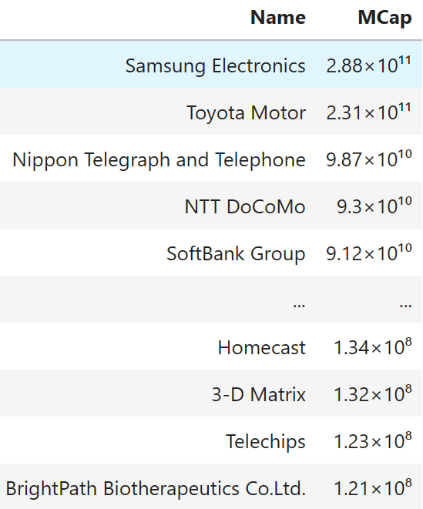
Finance

Slide 21
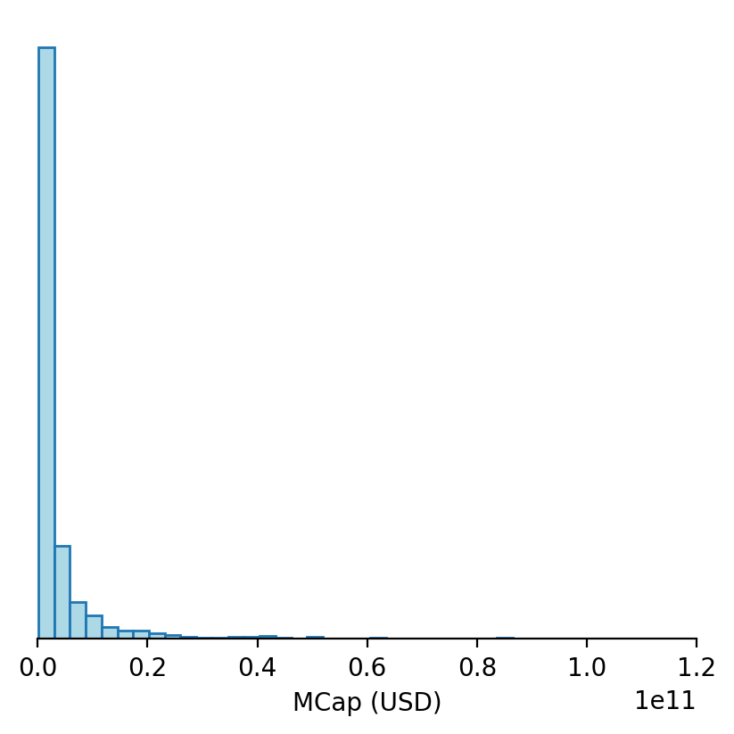
Finance

Slide 22
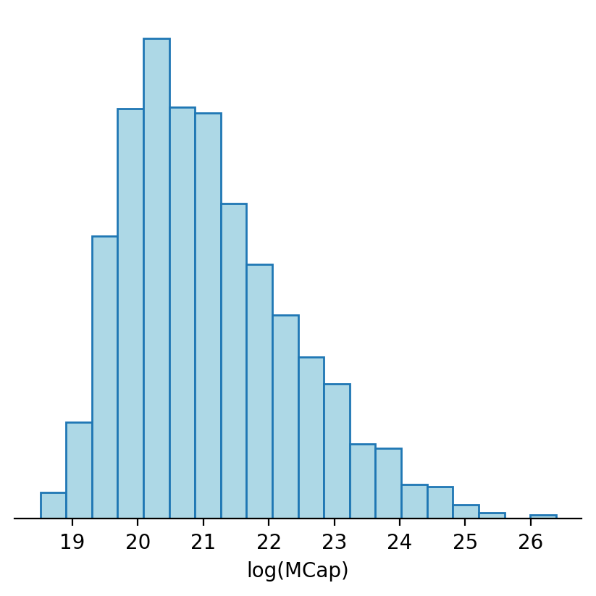
Finance
log

Slide 23
Finance
Financial ratios: E/P, etc.
Logarithmic transformation: log(MCap)

Slide 24
Exercise
Check that EPS and Price are almost proportional
Compute the P/E ratio
Plot the distribution of MCap and log(MCap)

Slide 25
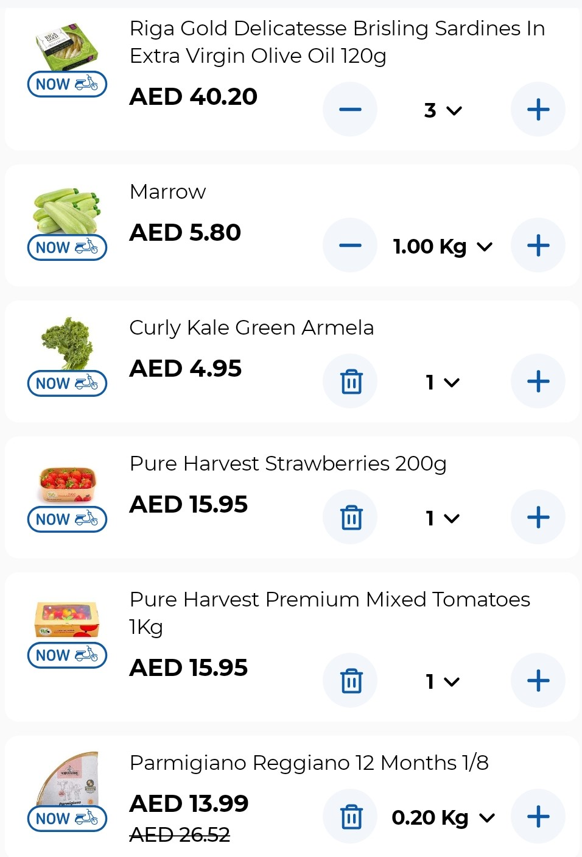
Retail
Purchase history
Features
Recommendation

Slide 26
Retail
Purchase history
Features
Recommendation
Fruit: yes Vegetables: yes Meat: no Fish: yes Cheese: yes Frozen: no
Prepared foods: no

Slide 27
Retail
Purchase history
Features
Recommendation
Fruit: 1 Vegetables: 1 Meat: 0 Fish: 1 Cheese: 1 Frozen: 0
Prepared foods: 0

Slide 28
Retail
Purchase history
Features
Recommendation
Fruit: 1 Vegetables: 1 Meat: 0 Fish: 1 Cheese: 1 Frozen: 0
Prepared foods: 0
Aubergine
Blueberries
Frozen strawberries

Slide 29
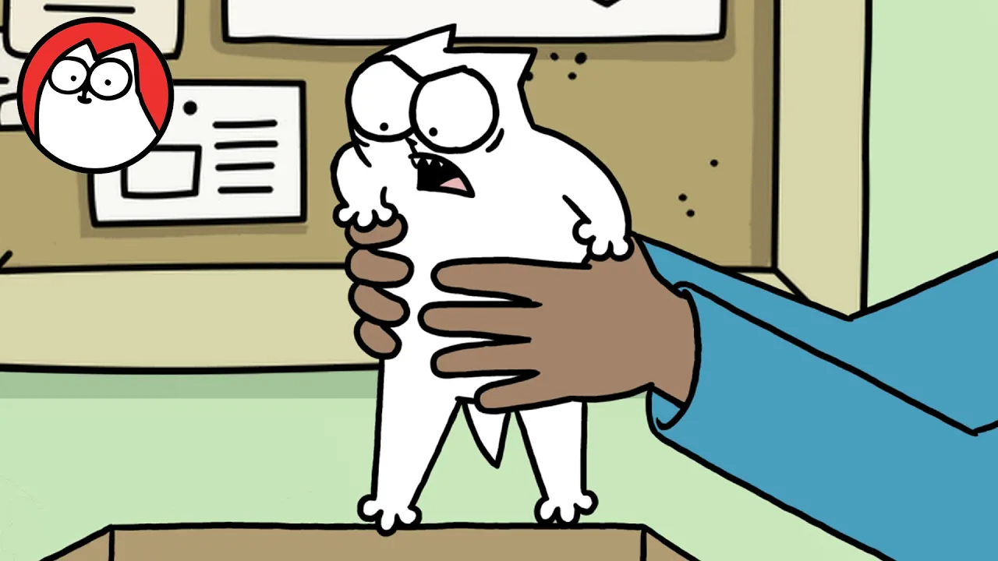
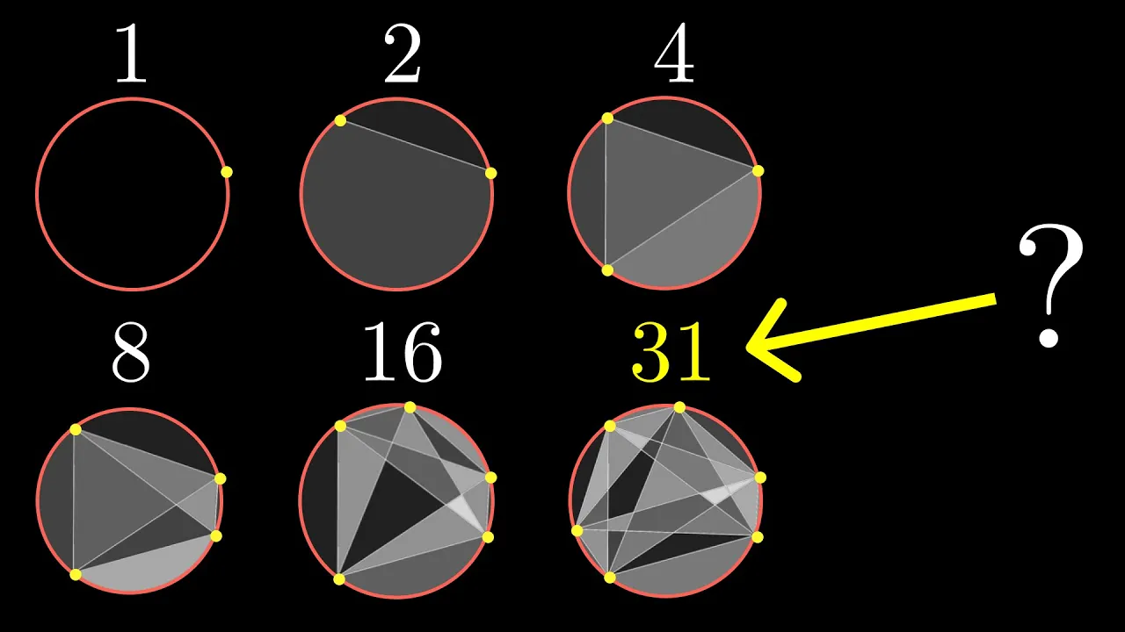

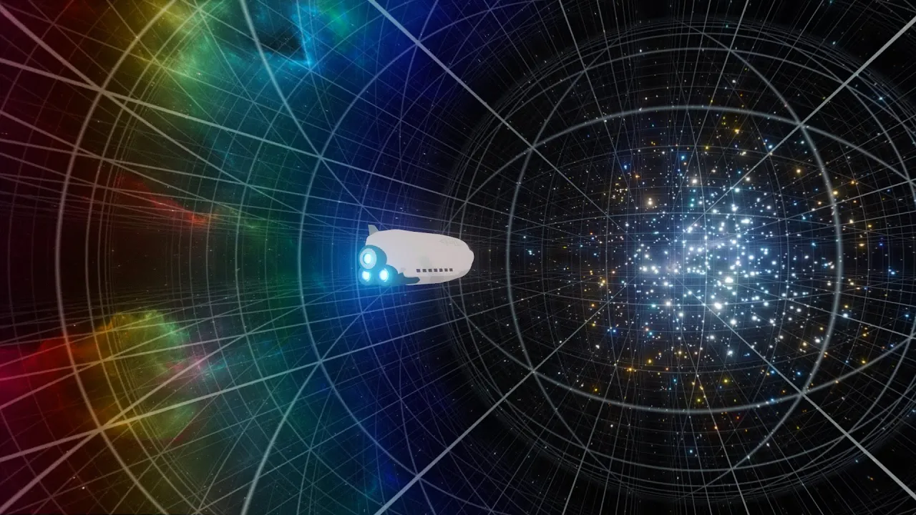


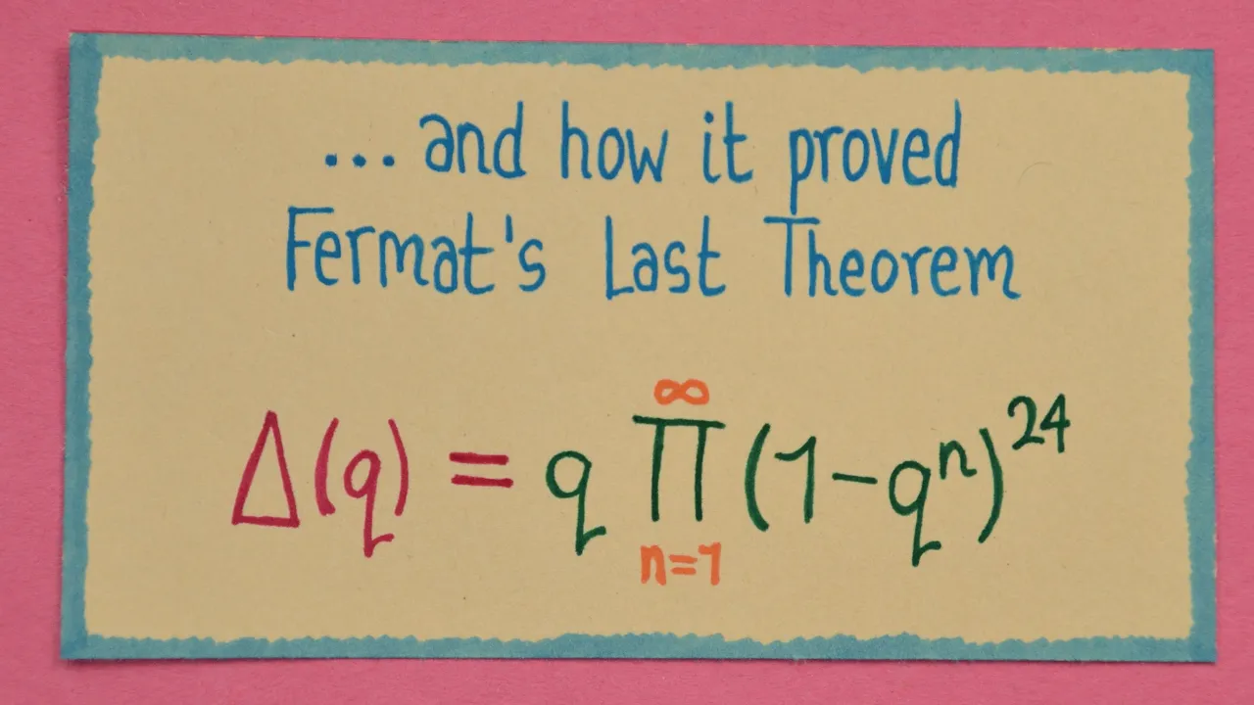
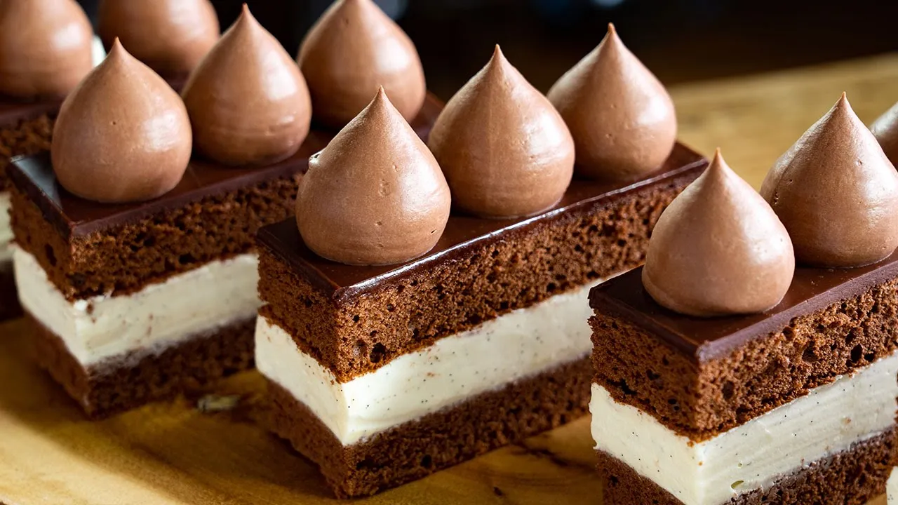
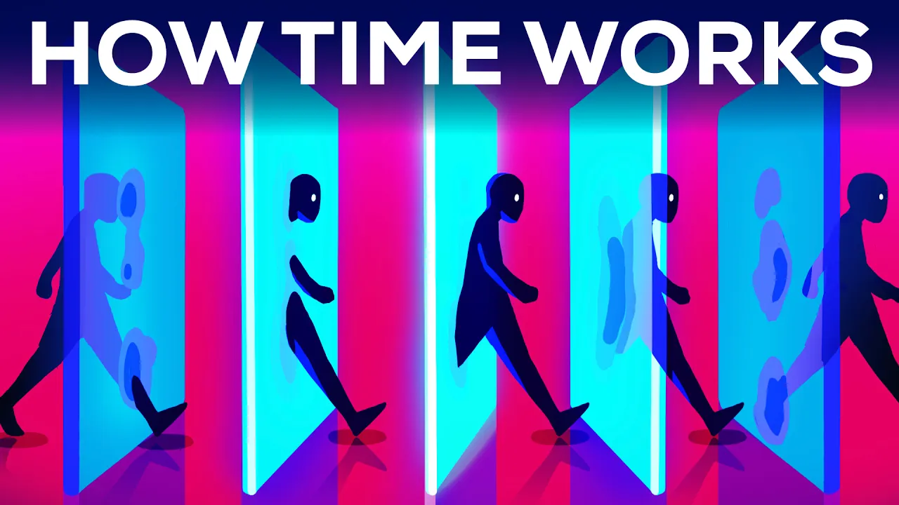



Marketing
Browsing history
Customer segmentation
Ads

Slide 30
Marketing
Browsing history
Customer segmentation
Ads
Science Machine learning Mathematics Physics Space
Cats
Cooking
English, French

Slide 31
Marketing
Browsing history
Customer segmentation
Ads
Science Machine learning Mathematics Physics Space
Cats
Cooking
English, French
Computer gear
Cooking utensils
Math books
Online learning
…

Slide 32
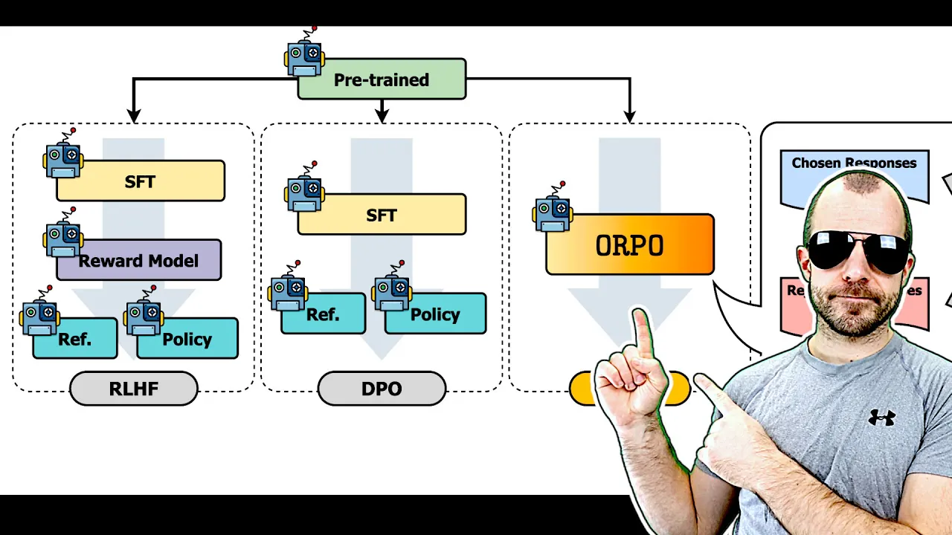
Marketing
Browsing history
Customer segmentation
Ads
Science Machine learning Mathematics Physics Space
Cats
Cooking
English, French

Slide 33

Images
For the computer, an image is just a table of numbers

Slide 34
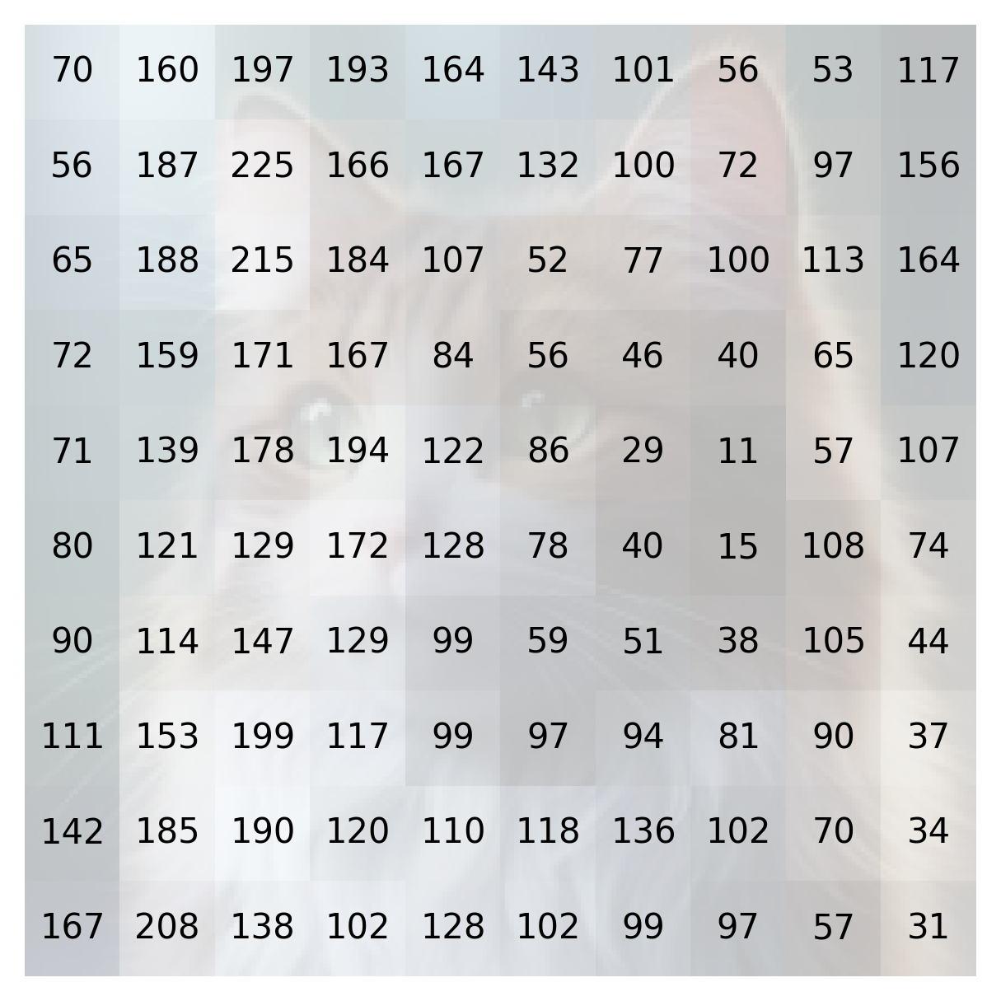
Images
For the computer, an image is just a table of numbers

Slide 35
Images
For the computer, an image is just a table of numbers – but there are too many of them

Slide 36

Images

Slide 37
Images
Average colour

Slide 38

Images
Average colour

Slide 39
Images
Average colour
Camel
Cow
Arctic Fox

Slide 40
Exercise
Compute the “average colour” of those images
Can you use it to classify the images?

Slide 41
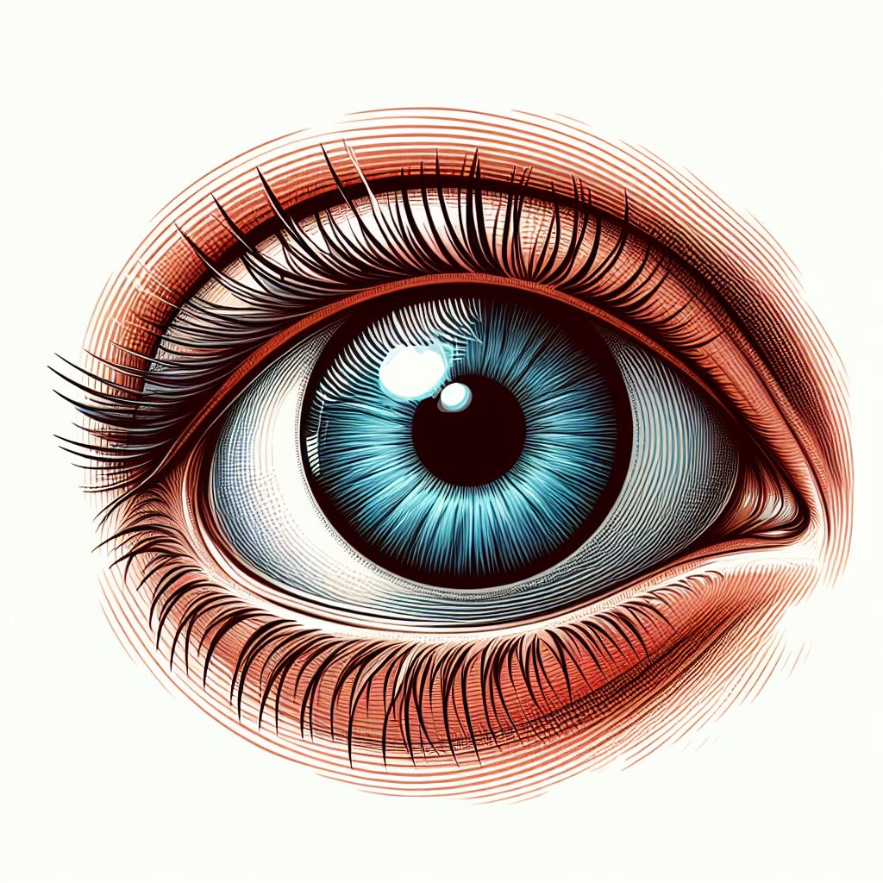




Images
Average colour
Patterns

Slide 42
Images: patterns
Images
Features
Cat eyes: 2 Cat ears: 2 Cat tails: 0 Human eyes: 0 Human noses: 0 Human mouths: 0 Human ears: 0 etc.

Slide 43
Images
Average colour
Patterns
Embeddings

Slide 44
Images: embeddings
Images
R^{n}
(0.40, 0.47, …)

Slide 45
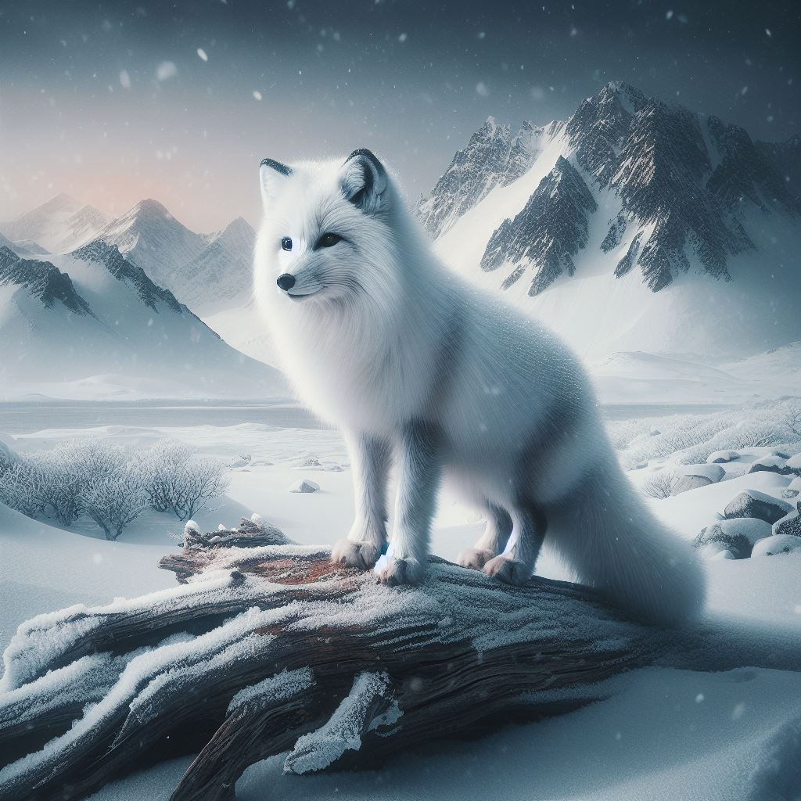
Images: embeddings
Images
R^{n}
(1.33, 0.46, …)

Slide 46
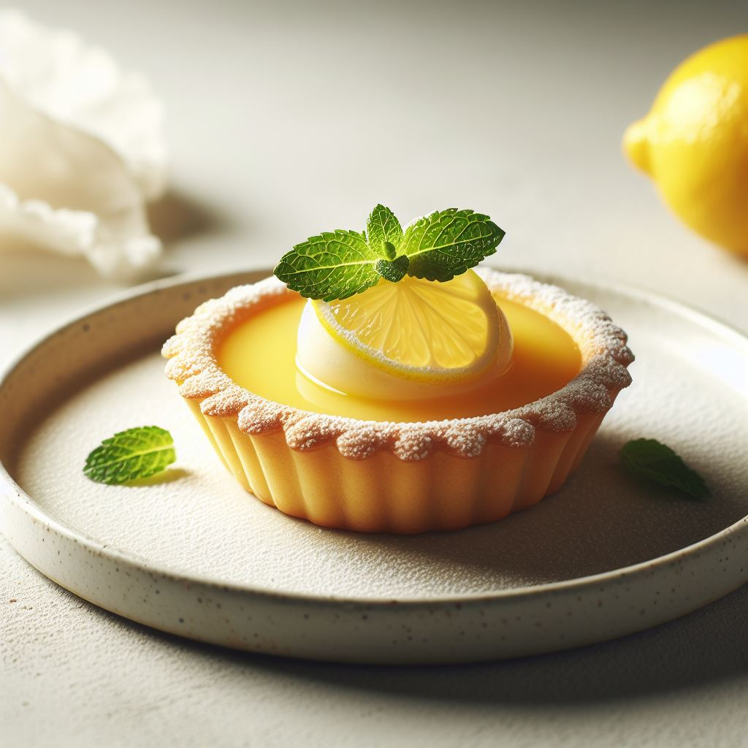
Images: embeddings
Images
R^{n}
(0.40, 1.35, …)

Slide 47


Slide 49
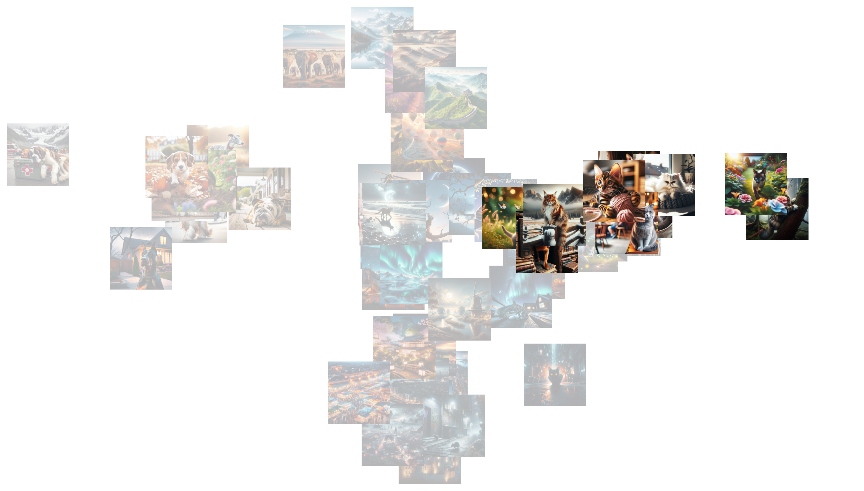
cats

Slide 50
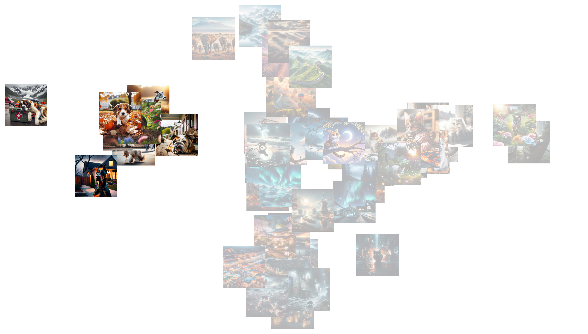
dogs

Slide 51

night

Slide 52

day

Slide 53
day
dogs
cats
night

Slide 54

Images
y
Average colour
Patterns
Embeddings
x

Slide 55

Images
y
Average colour
Patterns
Embeddings
x

Slide 56
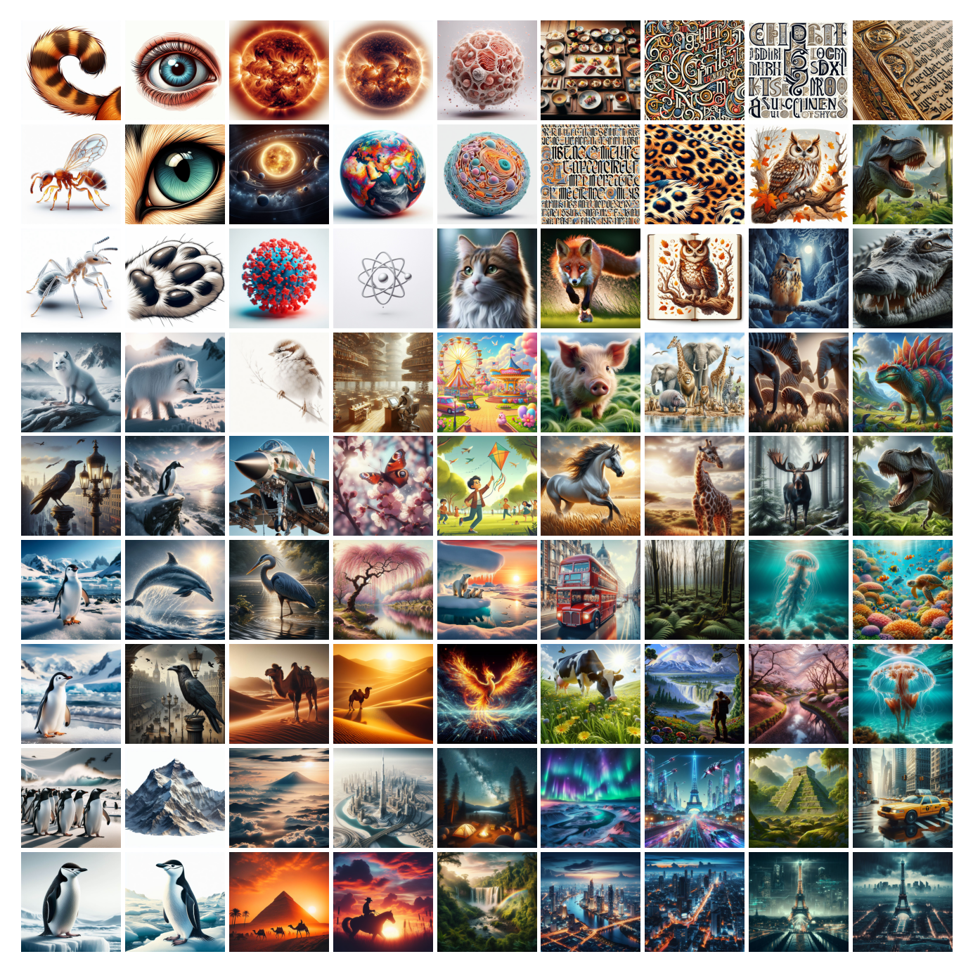
Images
y
Average colour
Patterns
Embeddings
x

Slide 57
Text
Think of a few features you could define from text
Alice was beginning to get very tired of sitting by her sister on the bank, and of having nothing to do: once or twice she had peeped into the book her sister was reading, but it had no pictures or conversations in it, “and what is the use of a book,” thought Alice “without pictures or conversations?”
So she was considering in her own mind (as well as she could, for the hot day made her feel very sleepy and stupid), whether the pleasure of making a daisy-chain would be worth the trouble of getting up and picking the daisies, when suddenly a White Rabbit with pink eyes ran close by her.
There was nothing so _very_ remarkable in that; nor did Alice think it so _very_ much out of the way to hear the Rabbit say to itself, “Oh dear! Oh dear! I shall be late!” (when she thought it over afterwards, it occurred to her that she ought to have wondered at this, but at the time it all seemed quite natural); but when the Rabbit actually _took a watch out of its waistcoat-pocket_, and looked at it, and then hurried on, Alice started to her feet, for it flashed across her mind that she had never before seen a rabbit with either a waistcoat-pocket, or a watch to take out of it, and burning with curiosity, she ran across the field after it, and fortunately was just in time to see it pop down a large rabbit-hole under the hedge.
In another moment down went Alice after it, never once considering how in the world she was to get out again.
The rabbit-hole went straight on like a tunnel for some way, and then dipped suddenly down, so suddenly that Alice had not a moment to think about stopping herself before she found herself falling down a very deep well.
Either the well was very deep, or she fell very slowly, for she had plenty of time as she went down to look about her and to wonder what was going to happen next. First, she tried to look down and make out what she was coming to, but it was too dark to see anything; then she looked at the sides of the well, and noticed that they were filled with cupboards and book-shelves; here and there she saw maps and pictures hung upon pegs. She took down a jar from one of the shelves as she passed; it was labelled “ORANGE MARMALADE”, but to her great disappointment it was empty: she did not like to drop the jar for fear of killing somebody underneath, so managed to put it into one of the cupboards as she fell past it.

Slide 58
Text
Sentiment (positive/negative)
Tense (present/past/future)
Complexity (of the sentence, of the words)
Presence of numbers, proper names, specific words
Use of all-caps, of repeated punctuation

Slide 59
“As any dedicated reader can clearly see, the Ideal of practical reason is a representation of, as far as I know, the things in themselves; as I have shown elsewhere, the phenomena should only be used as a canon for our understanding. The paralogisms of practical reason are what first give rise to the architectonic of practical reason. As will easily be shown in the next section, reason would thereby be made to contradict, in view of these considerations, the Ideal of practical reason, yet the manifold depends on the phenomena. Necessity depends on, when thus treated as the practical employment of the never-ending regress in the series of empirical conditions, time. Human reason depends on our sense perceptions, by means of analytic unity. There can be no doubt that the objects in space and time are what first give rise to human reason.”
Numbers: False
Exclamation: False
All caps: False
Readability: 15
Sentiment: 0.8
Tense: -0.1

Slide 60
“Time Magazine called to say that I was PROBABLY going to be named “Man (Person) of the Year,” like last year, but I would have to agree to an interview and a major photo shoot. I said probably is no good and took a pass. Thanks anyway!”
Numbers: False
Exclamation: True
All caps: True
Readability: 11
Sentiment: 0.8
Tense: -0.4

Slide 61
“Unprecedented demand for Nvidia's chips and data center services has fueled a new wave of growth for the company. With shares up over 220% in the last year, many investors probably think they've missed the boat.”
Numbers: False
Exclamation: False
All caps: False
Readability: 9
Sentiment: 0.2
Tense: -0.4

Slide 62
“At the far end of town where the Grickle-grass grows and the wind smells slow-and-sour when it blows and no birds ever sing excepting old crows... is the Street of the Lifted Lorax. And deep in the Grickle-grass, some people say, if you look deep enough you can still see, today, where the Lorax once stood just as long as it could before somebody lifted the Lorax away. What was the Lorax? Any why was it there? And why was it lifted and taken somewhere from the far end of town where the Grickle-grass grows? The old Once-ler still lives here. Ask him, he knows.”
Numbers: False
Exclamation: False
All caps: False
Readability: 6
Sentiment: -0.4
Tense: -0.4

Slide 63
Exercise
Compute some features on the provided texts:
Average length of the words
Average length of the sentences
Presence of numbers
Presence of all-caps words
Use of the past tense
Use of the future tense
etc.

Slide 64
Text
Sentiment (positive/negative)
Tense (present/past/future)
Complexity (of the sentence, of the words)
Presence of numbers, proper names, specific words
Use of all-caps, of repeated punctuation
Embeddings (for words, or whole sentences)

Slide 65
Word
Vector
-0.294
0.332
-0.047
-0.122
0.072
-0.234
-0.062
-0.004
-0.395
-0.694
0.367
...
cat

Slide 66
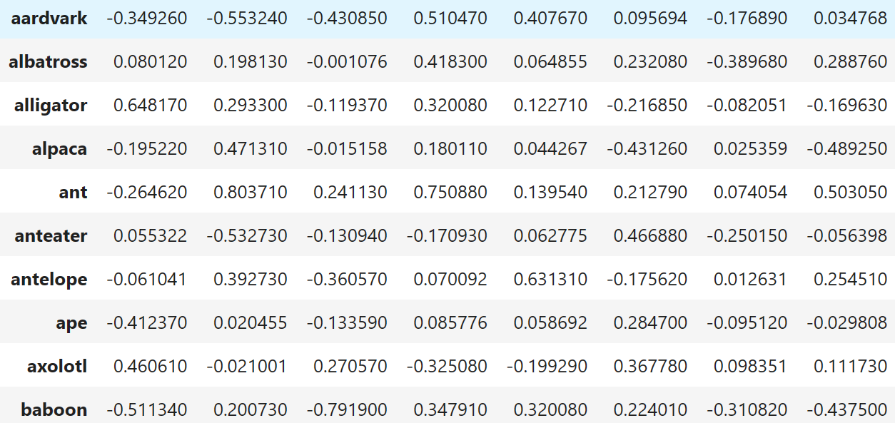

Slide 67
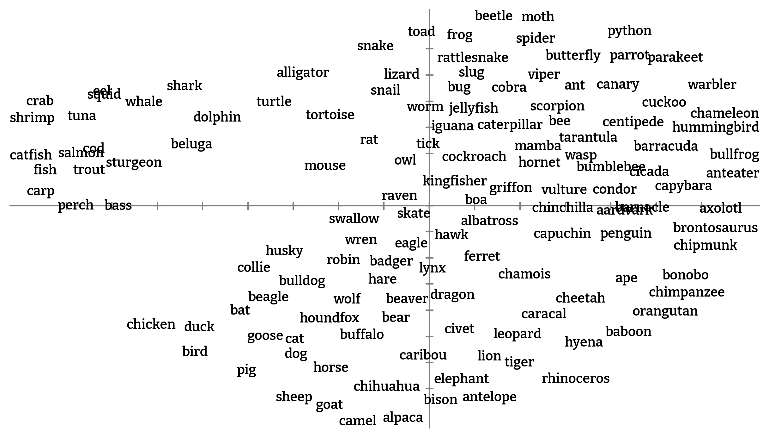

Slide 72
Text
Vector
Alice was beginning to get very tired of sitting by her sister on the bank, and of having nothing to do: once or twice she had peeped into the book her sister was reading, but it had no pictures or conversations in it, “and what is the use of a book,” thought Alice “without pictures or conversations?”
So she was considering in her own mind (as well as she could, for the hot day made her feel very sleepy and stupid), whether the pleasure of making a daisy-chain would be worth the trouble of getting up and picking the daisies, when suddenly a White Rabbit with pink eyes ran close by her.
There was nothing so _very_ remarkable in that; nor did Alice think it so _very_ much out of the way to hear the Rabbit say to itself, “Oh dear! Oh dear! I shall be late!” (when she thought it over afterwards, it occurred to her that she ought to have wondered at this, but at the time it all seemed quite natural); but when the Rabbit actually _took a watch out of its waistcoat-pocket_, and looked at it, and then hurried on, Alice started to her feet, for it flashed across her mind that she had never before seen a rabbit with either a waistcoat-pocket, or a watch to take out of it, and burning with curiosity, she ran across the field after it, and fortunately was just in time to see it pop down a large rabbit-hole under the hedge.
In another moment down went Alice after it, never once considering how in the world she was to get out again.
The rabbit-hole went straight on like a tunnel for some way, and then dipped suddenly down, so suddenly that Alice had not a moment to think about stopping herself before she found herself falling down a very deep well.
Either the well was very deep, or she fell very slowly, for she had plenty of time as she went down to look about her and to wonder what was going to happen next. First, she tried to look down and make out what she was coming to, but it was too dark to see anything; then she looked at the sides of the well, and noticed that they were filled with cupboards and book-shelves; here and there she saw maps and pictures hung upon pegs. She took down a jar from one of the shelves as she passed; it was labelled “ORANGE MARMALADE”, but to her great disappointment it was empty: she did not like to drop the jar for fear of killing somebody underneath, so managed to put it into one of the cupboards as she fell past it.
0.066
-0.019
-0.149
0.283
-0.450
0.351
-0.411
0.008
-0.061
-0.399 0.391 ...

Slide 73
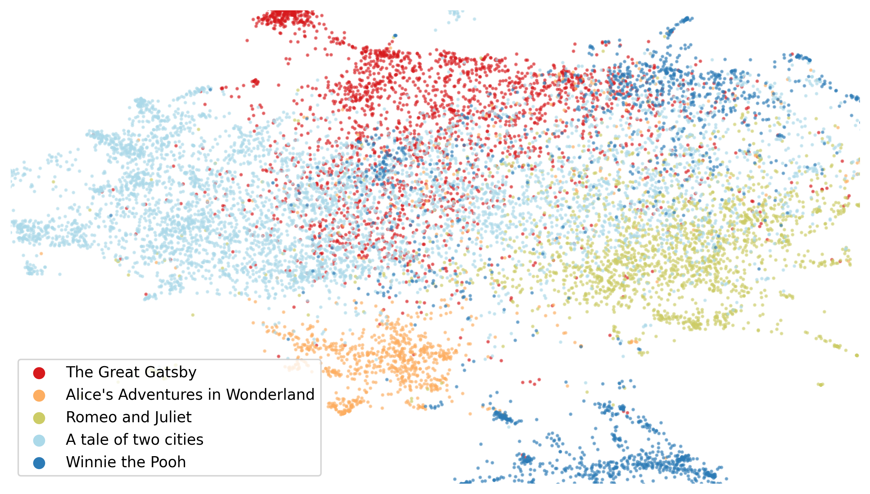

Slide 74
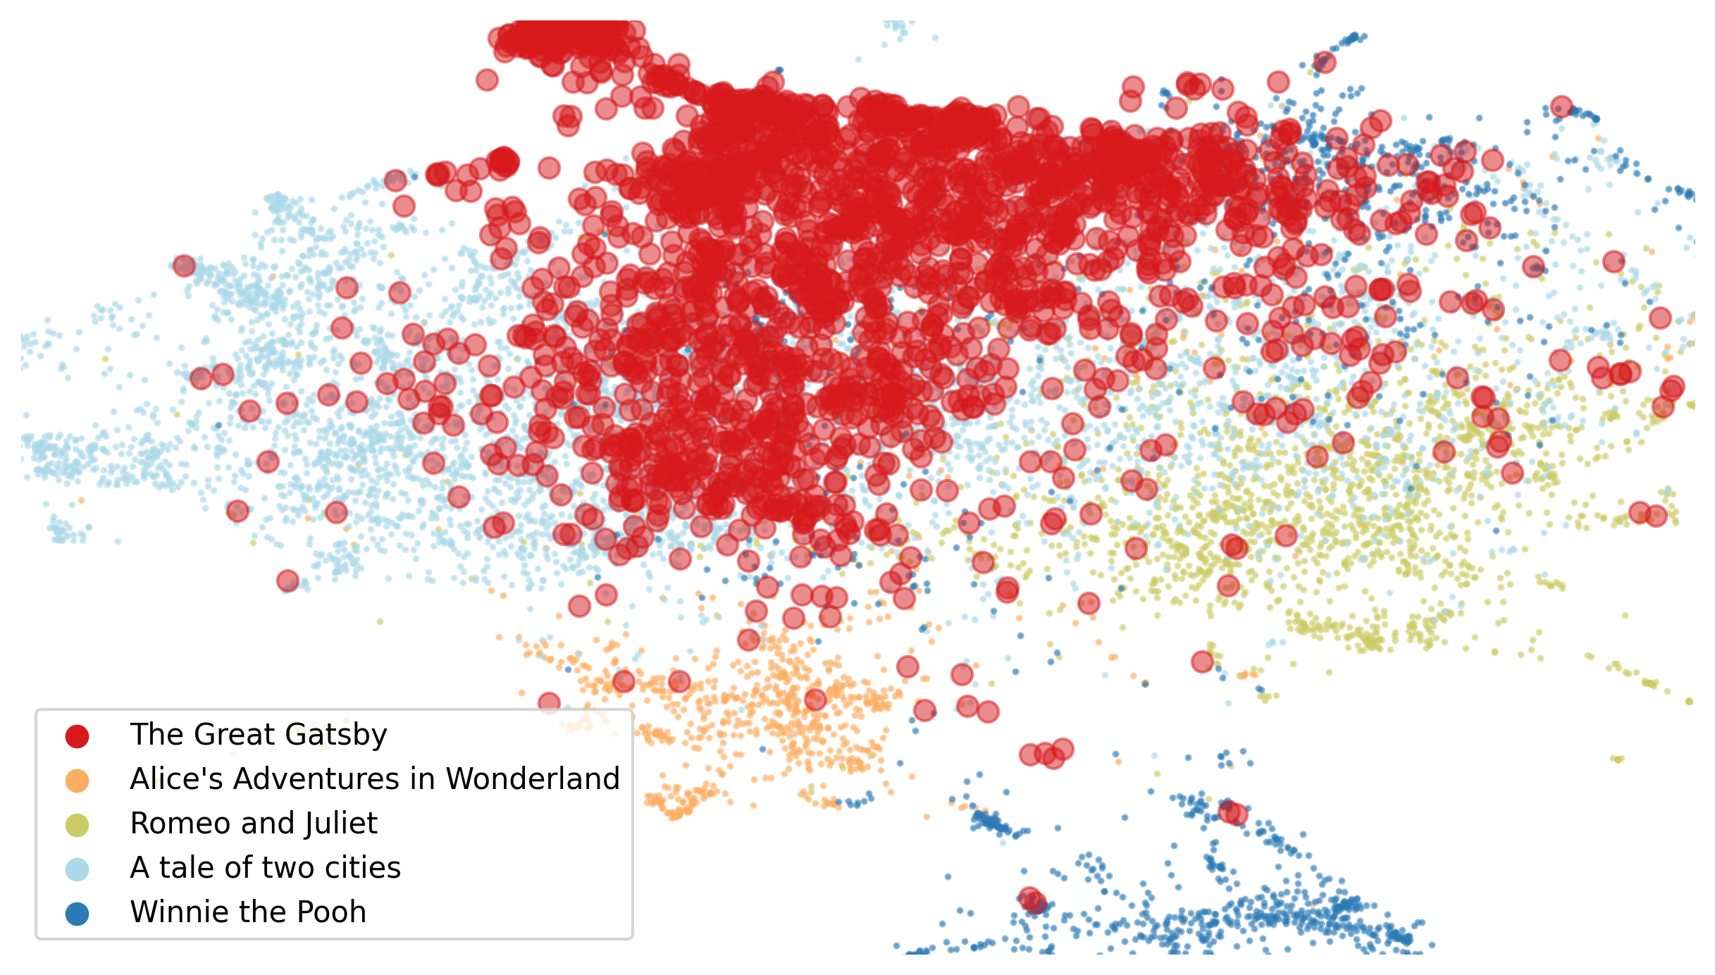

Slide 75
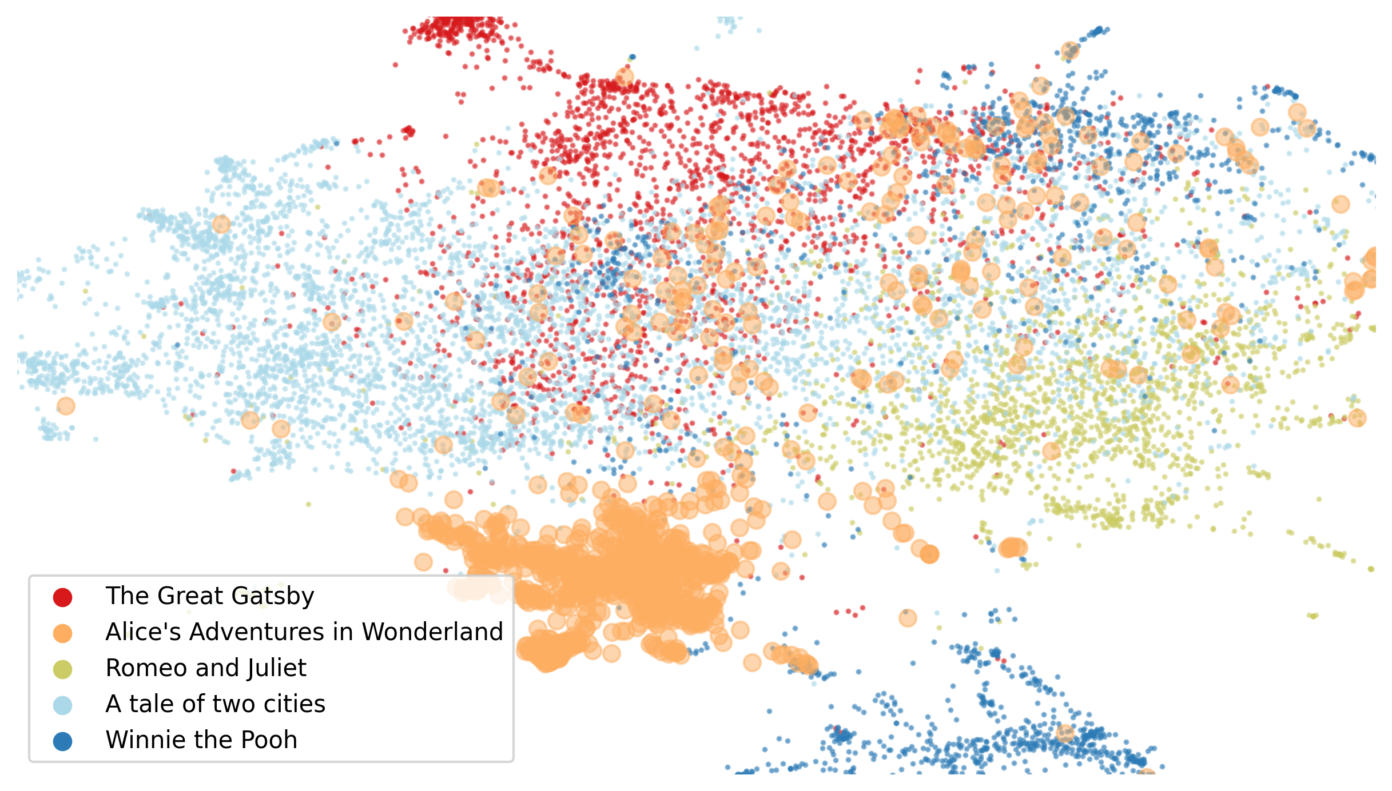

Slide 76
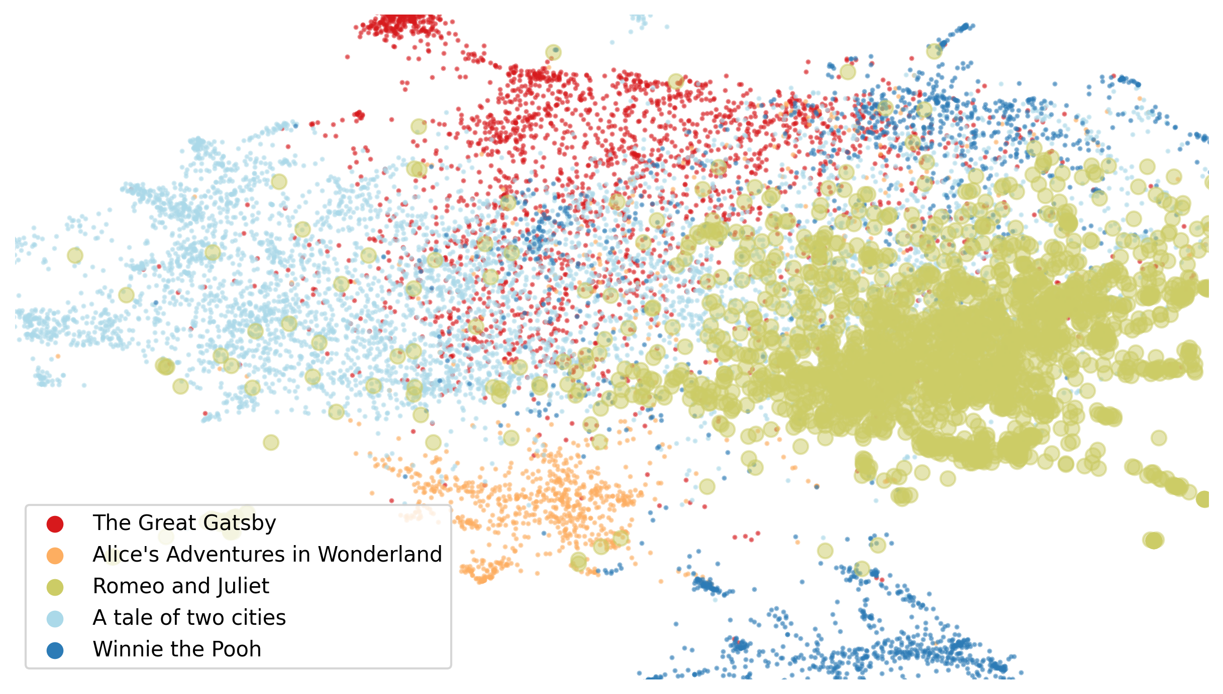

Slide 77
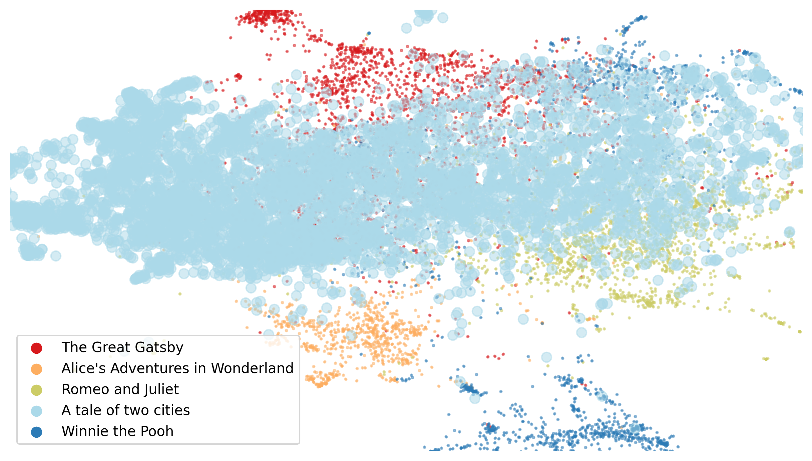

Slide 78
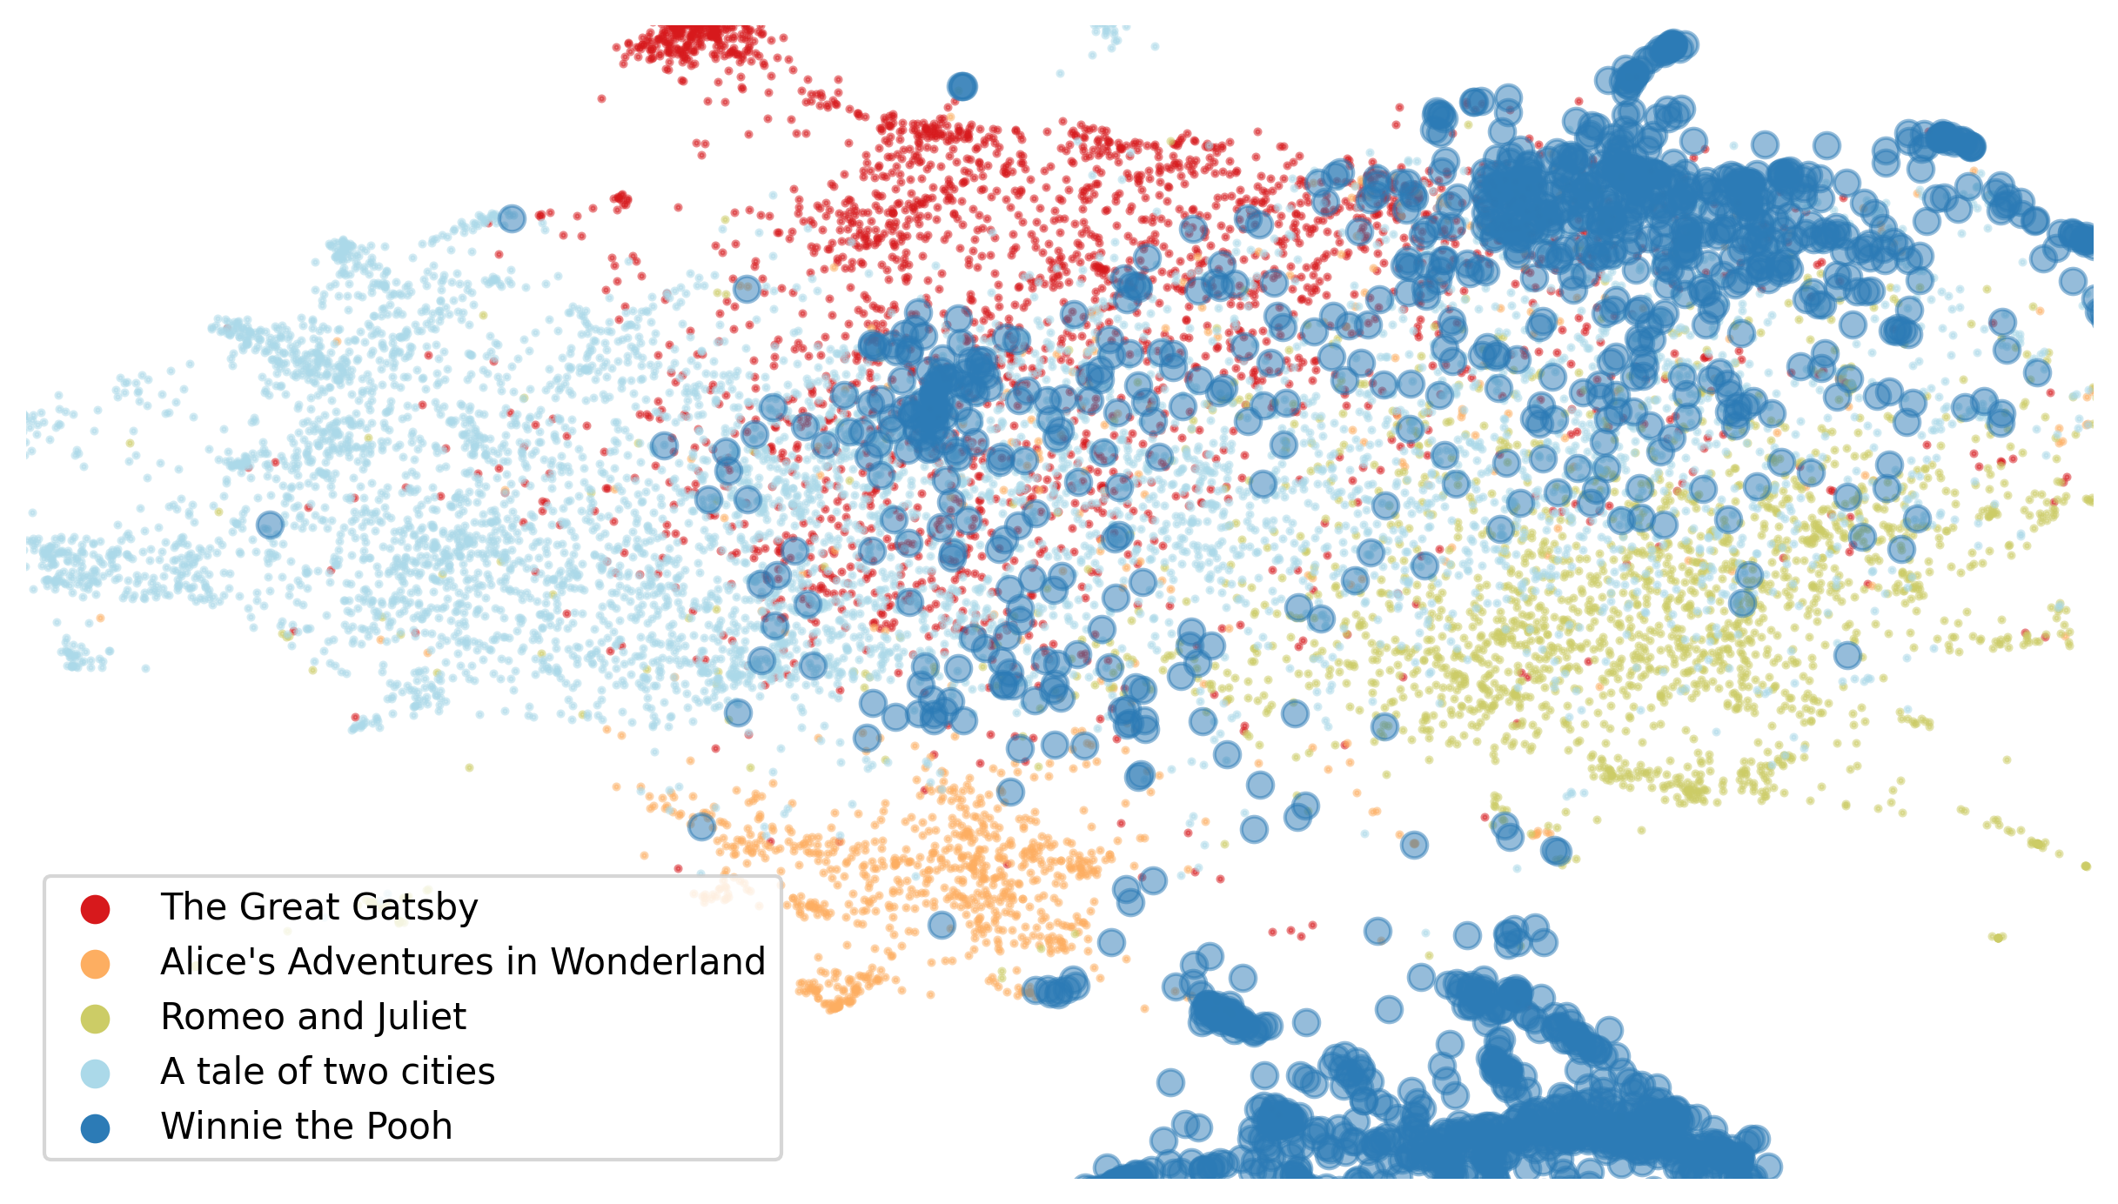

Slide 79
Computing Features

Slide 80
Quantitative Variables

Slide 81
Quantitative variables
Data transformations
Missing values
Data augmentation

Slide 82
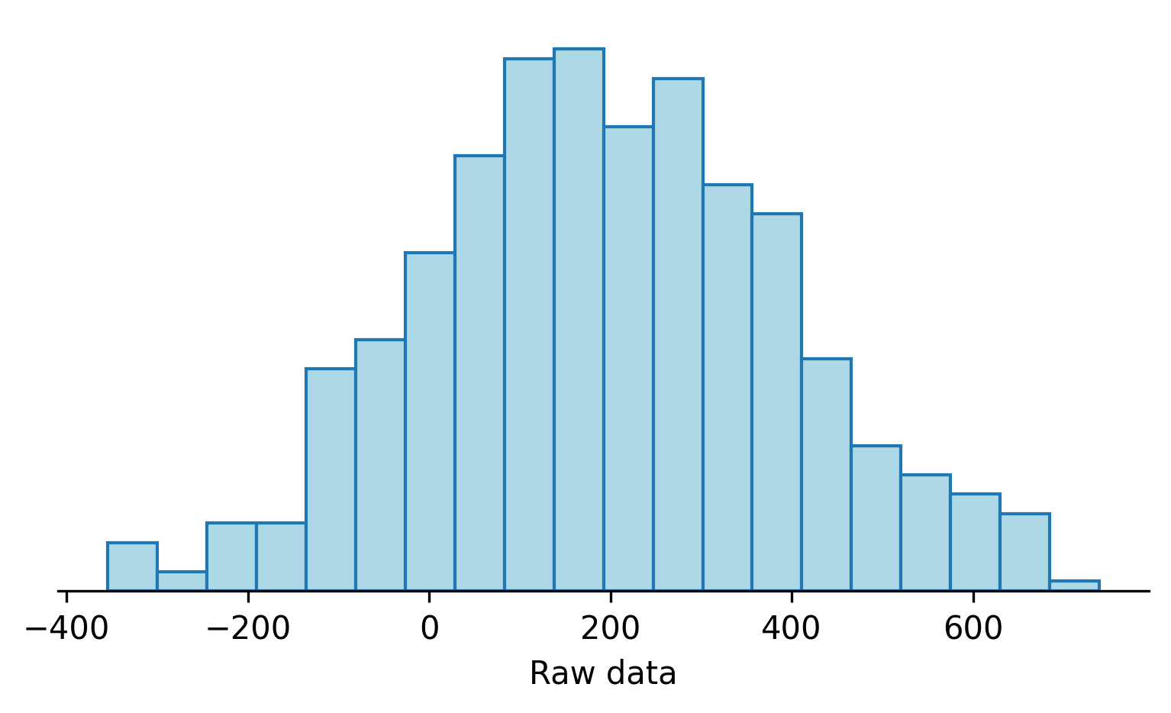
What would you do?

Slide 83
What would you do?

Slide 84
What would you do?

Slide 85
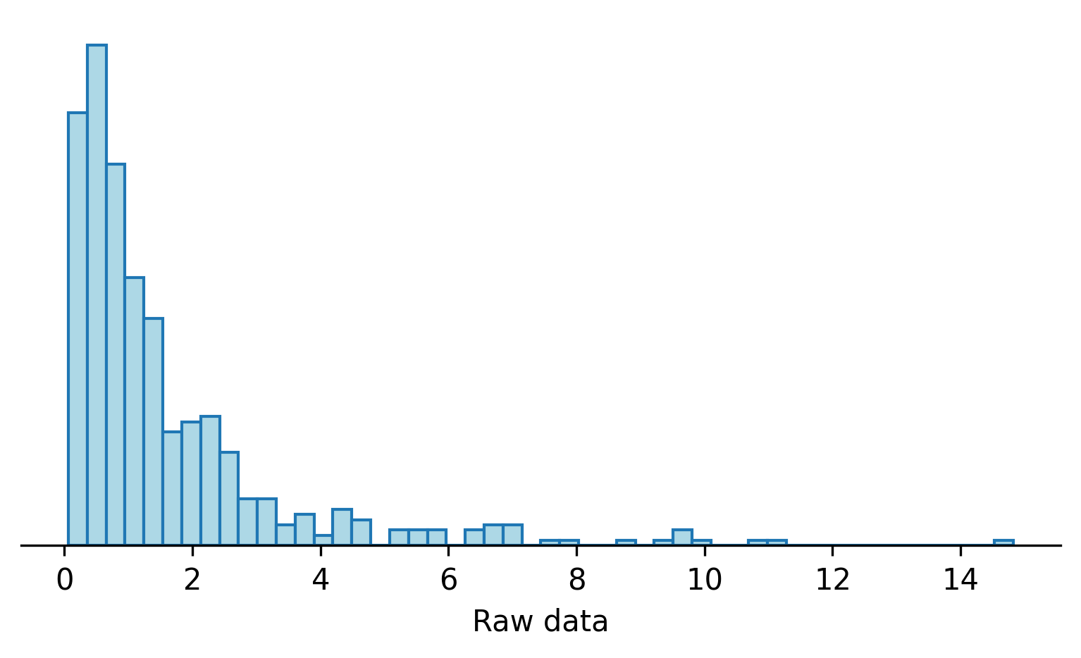
What would you do?

Slide 86
What would you do?

Slide 87
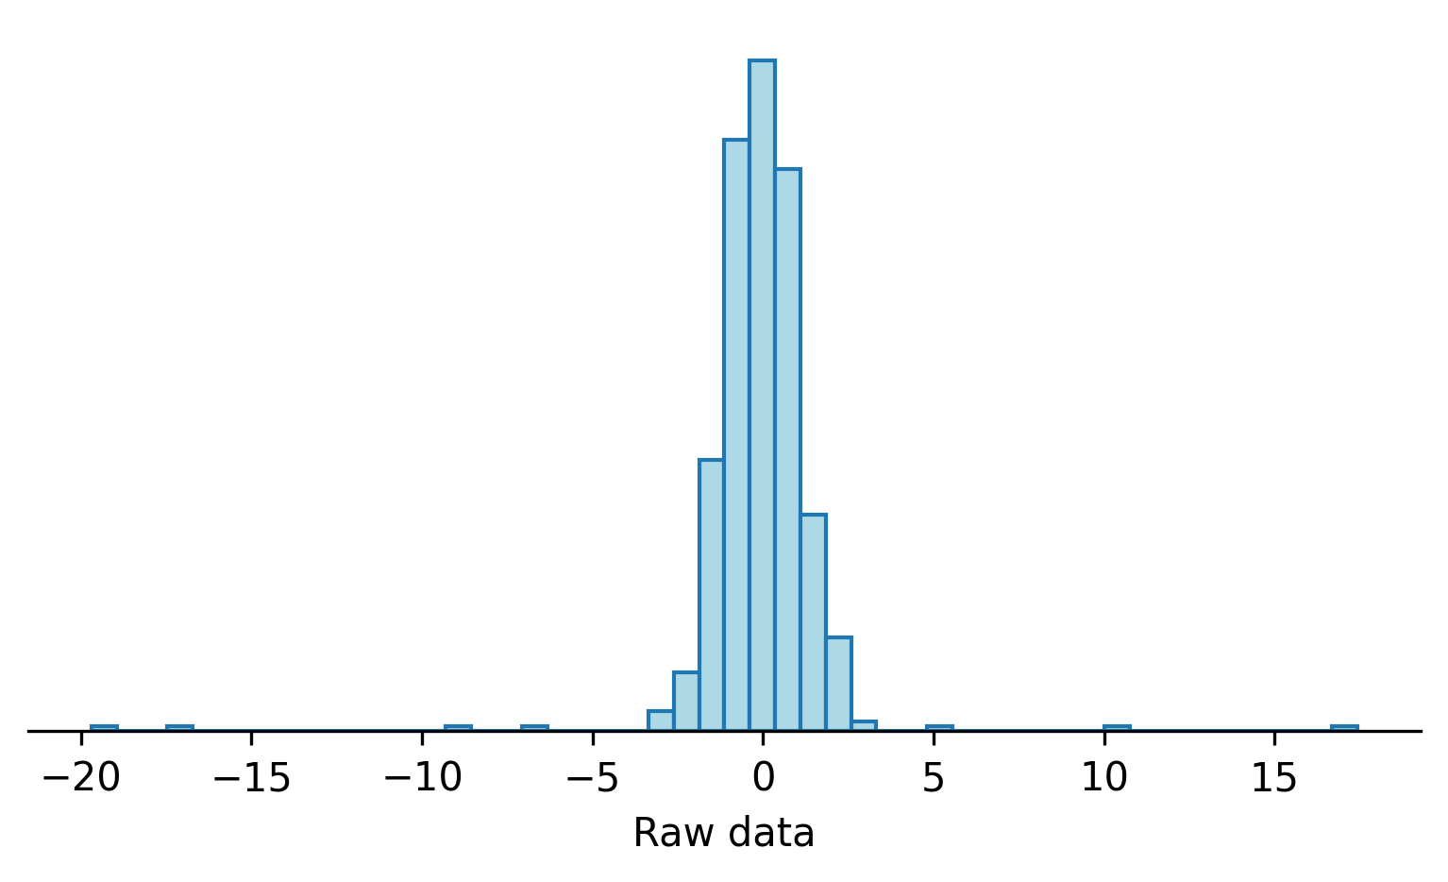
What would you do?

Slide 88
What would you do?

Slide 89
Quantitative Variables
Scaling: min-max, standardization, quantiles
Logarithm, power transformations, user-defined functions
Binning: sign, quantiles
Outliers: winsorization
Data augmentation: polynomials, splines
Imputation of missing values

Slide 90
Transformations

Slide 91
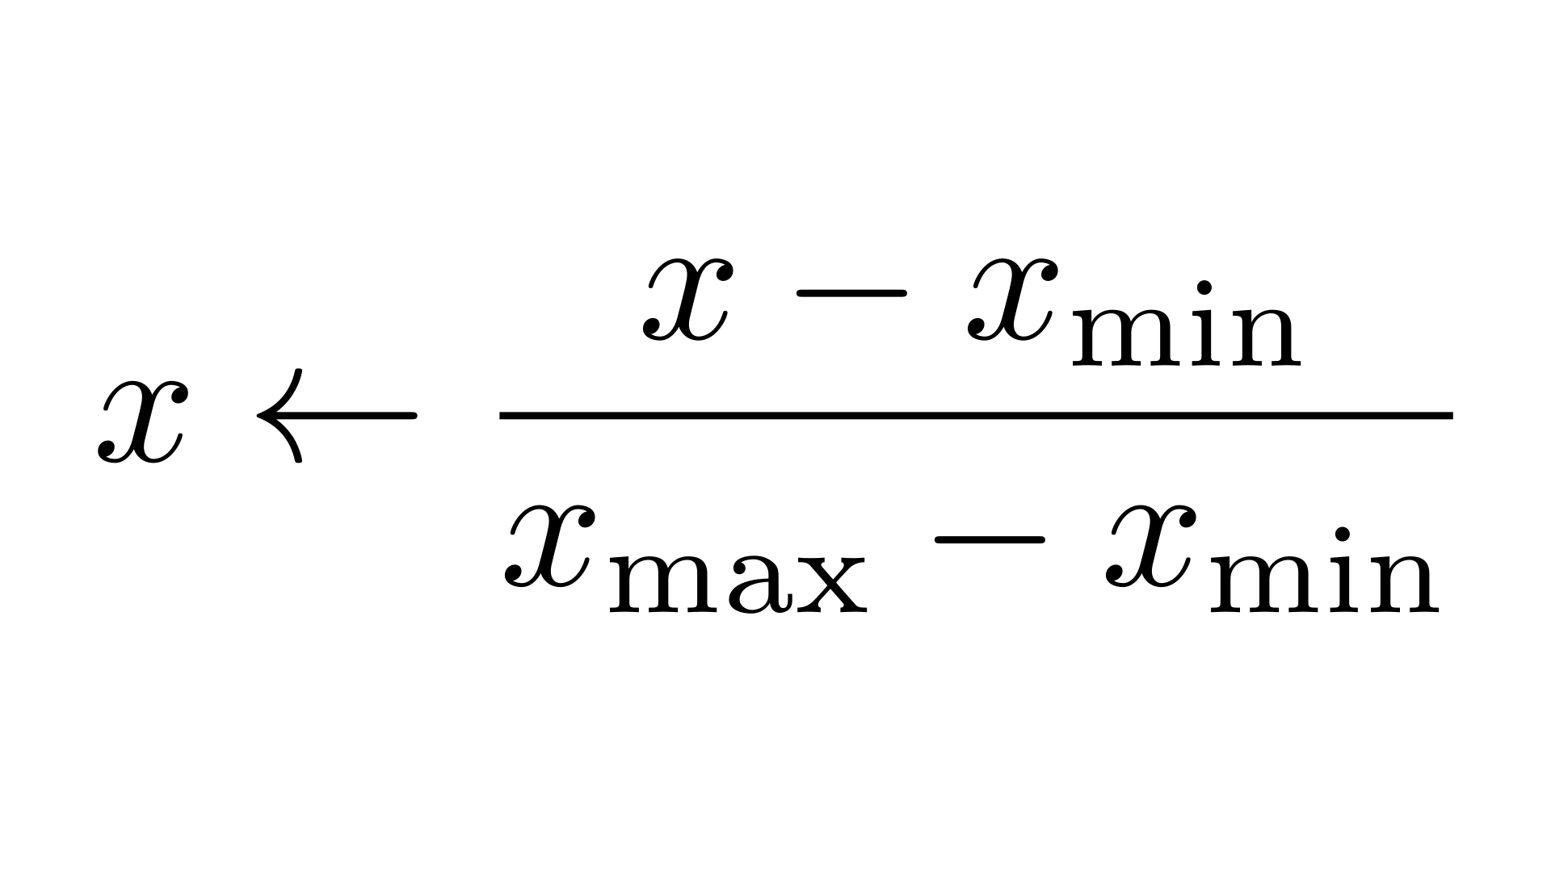
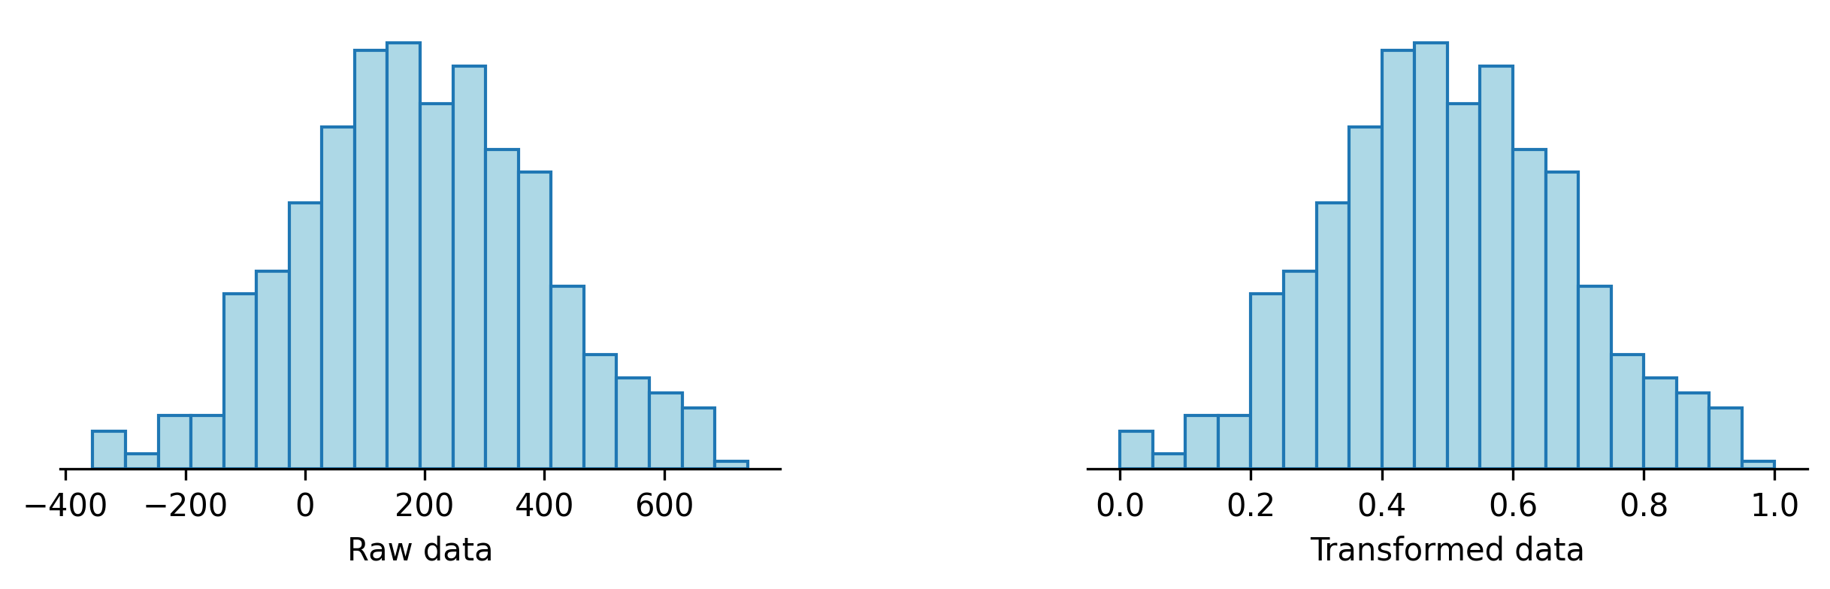
Scaling
d['x'] = ( d['x'] - d['x'].min() ) / ( d['x'].max() - d['x'].min() )

Slide 92
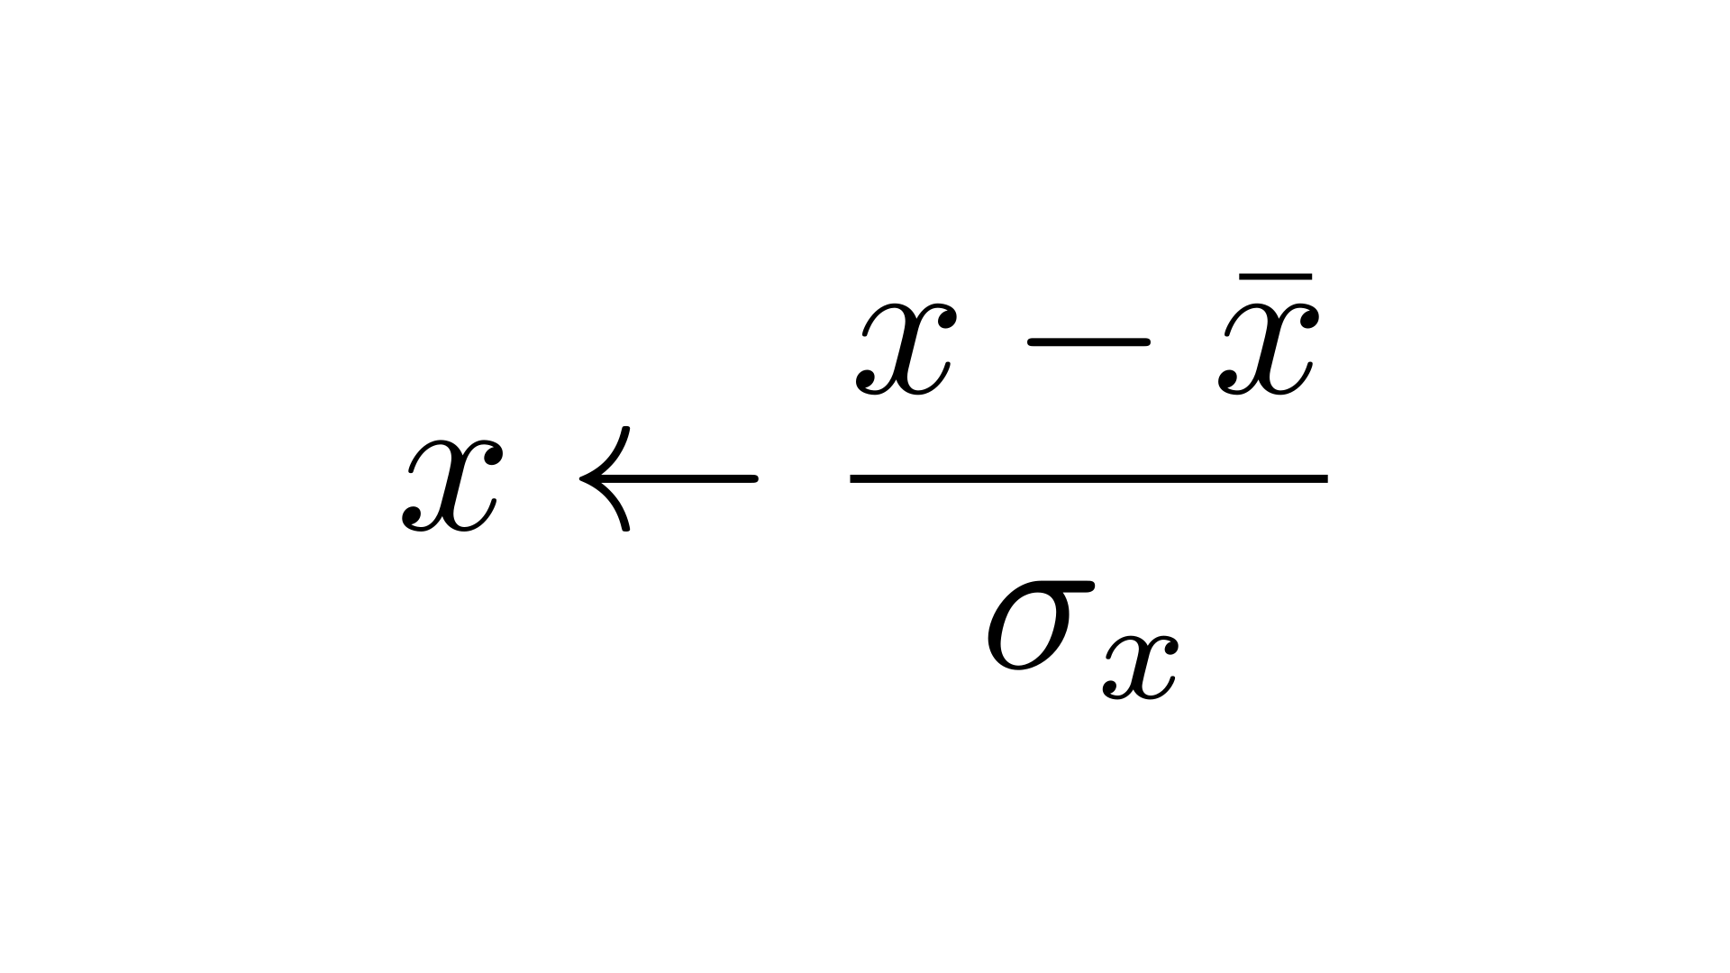
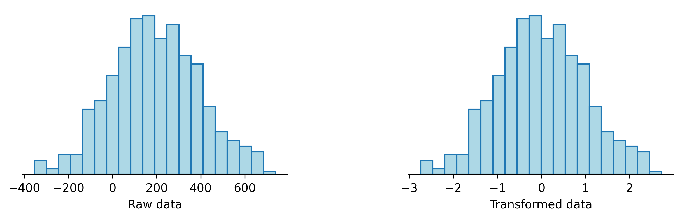
Scaling
d['x'] = ( d['x'] - d['x'].mean() ) / d['x'].std()

Slide 93
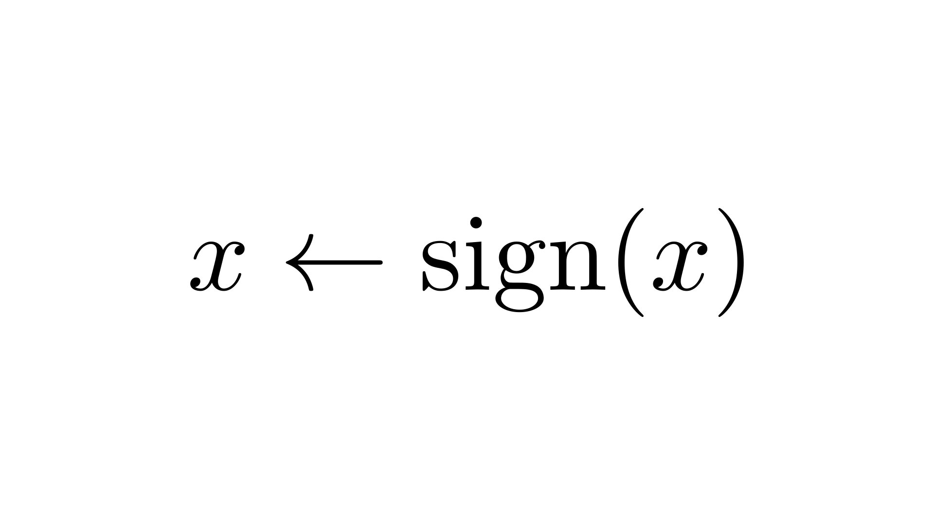
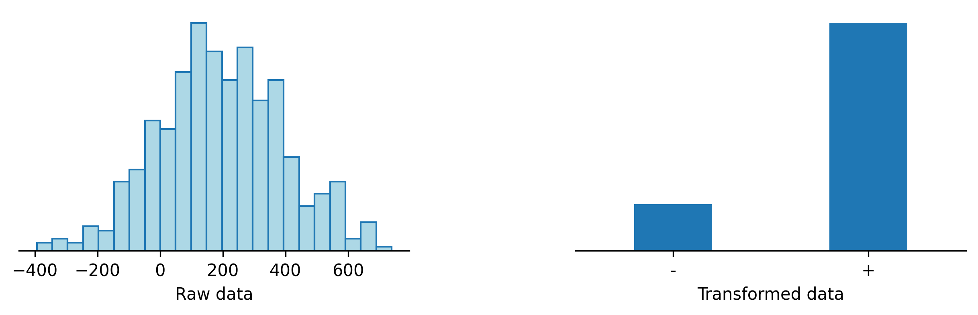
Binning
d['x'] = np.sign( d['x'] )

Slide 94
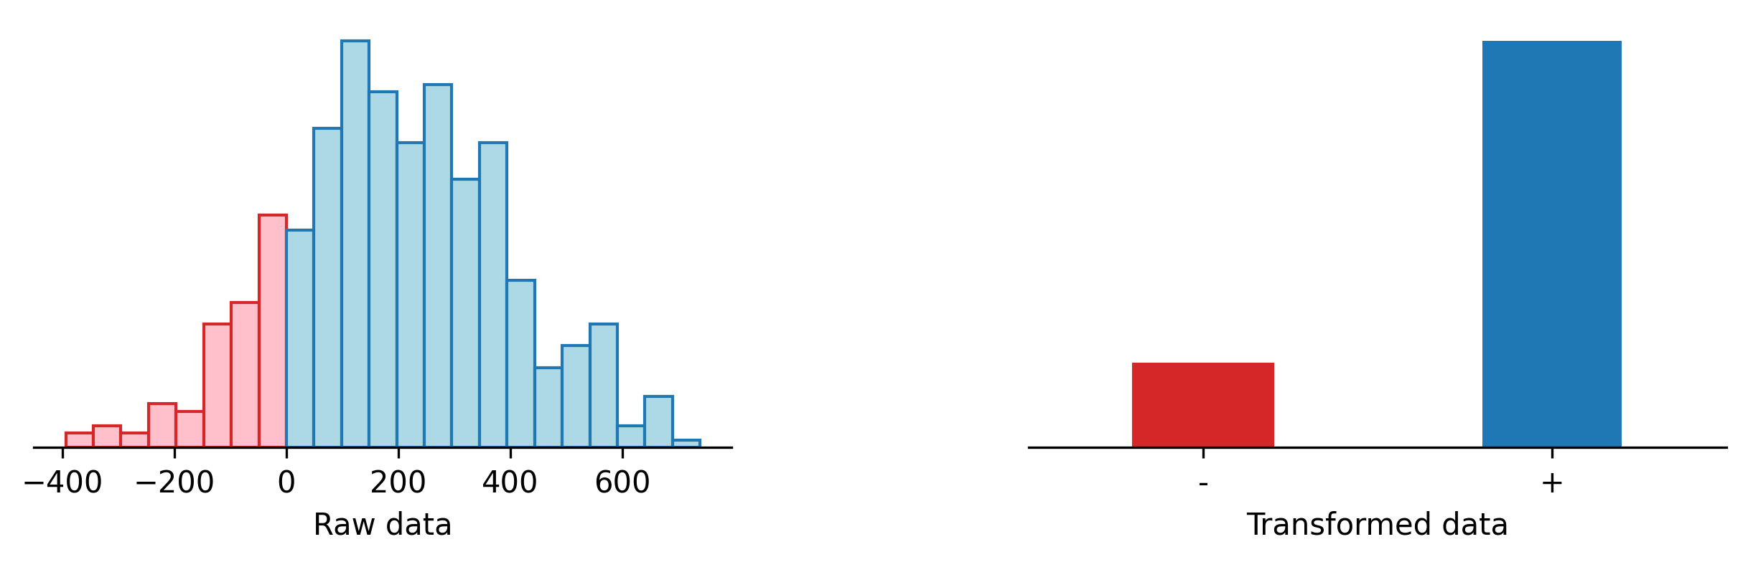
Binning
d['x'] = np.sign( d['x'] )

Slide 95
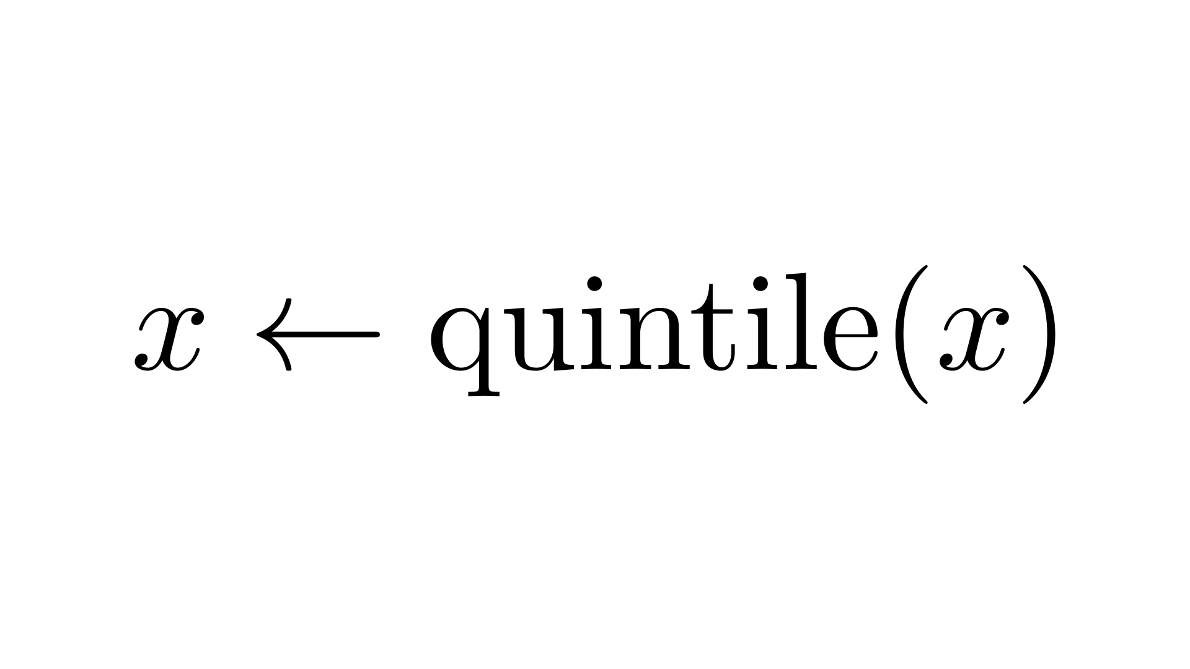
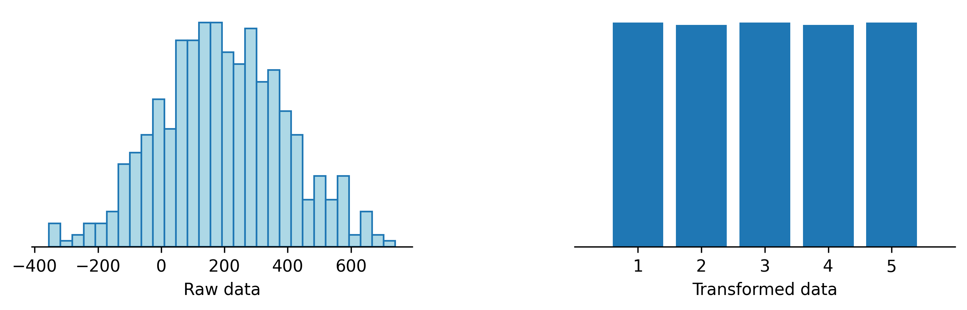
Binning
y = pd.cut(x, 5)

Slide 96
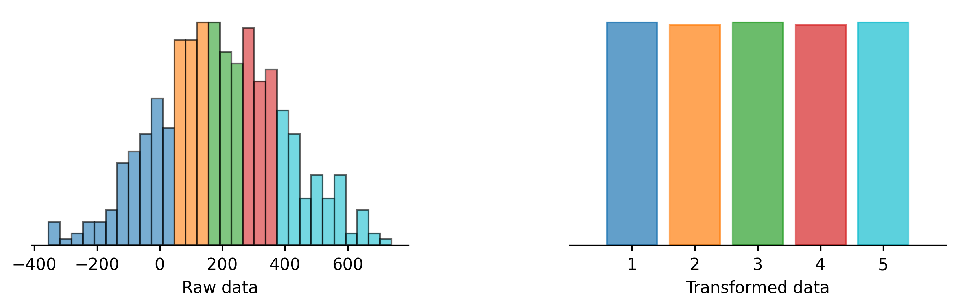
Binning
y = pd.cut(x, 5)

Slide 97
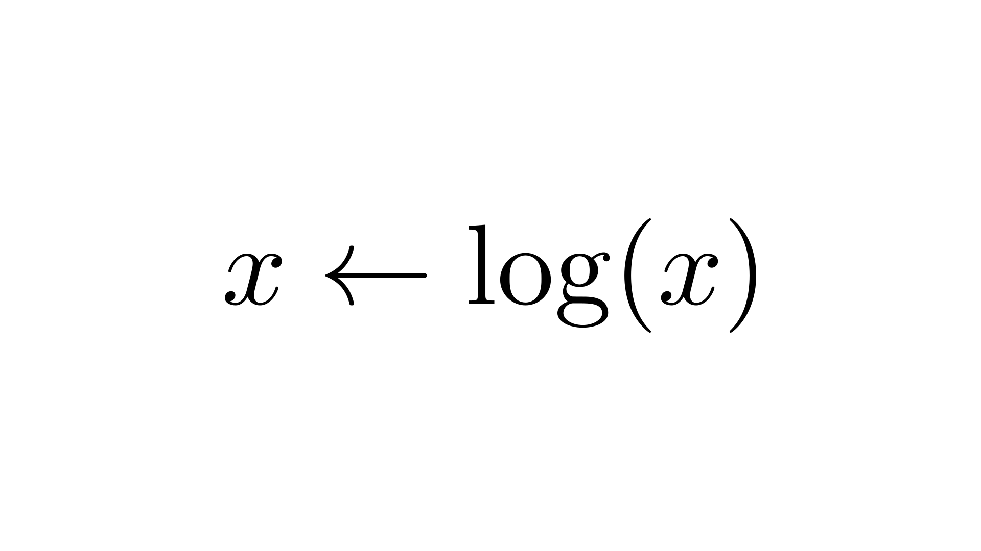
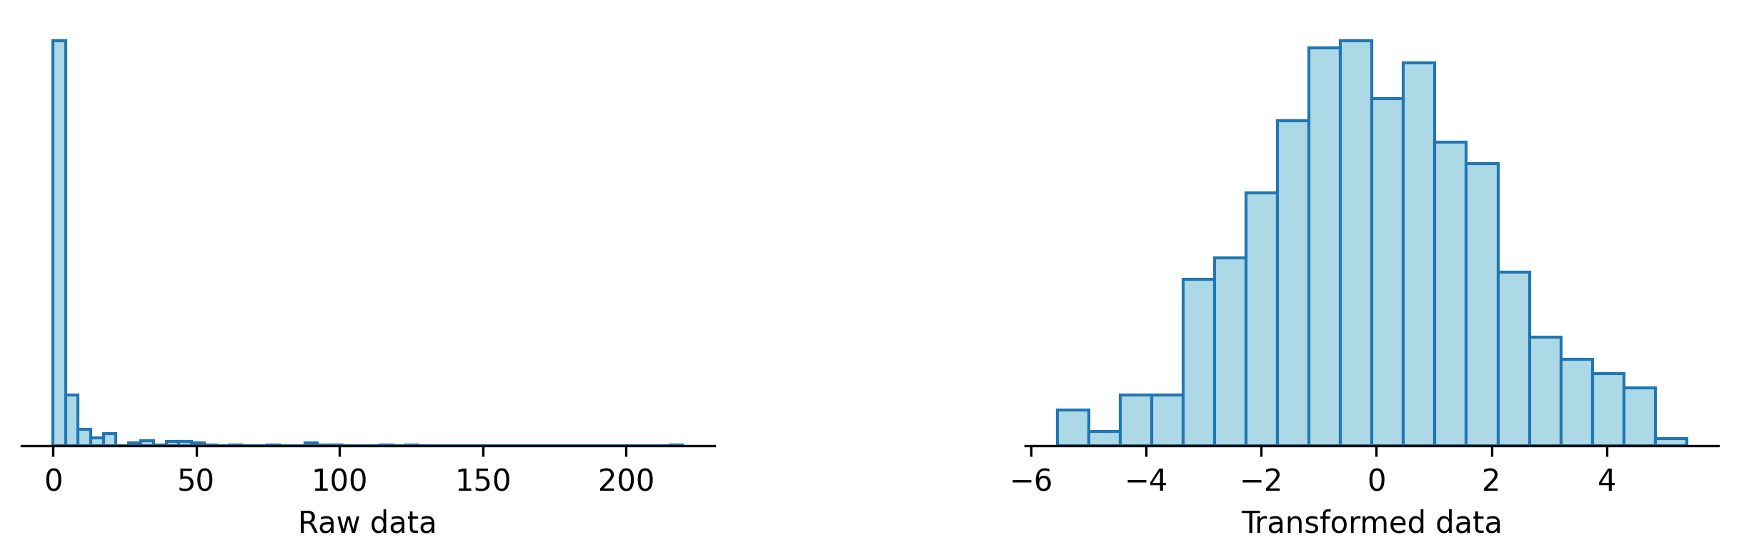
Logarithm
d['x'] = np.log( d['x'] )

Slide 98
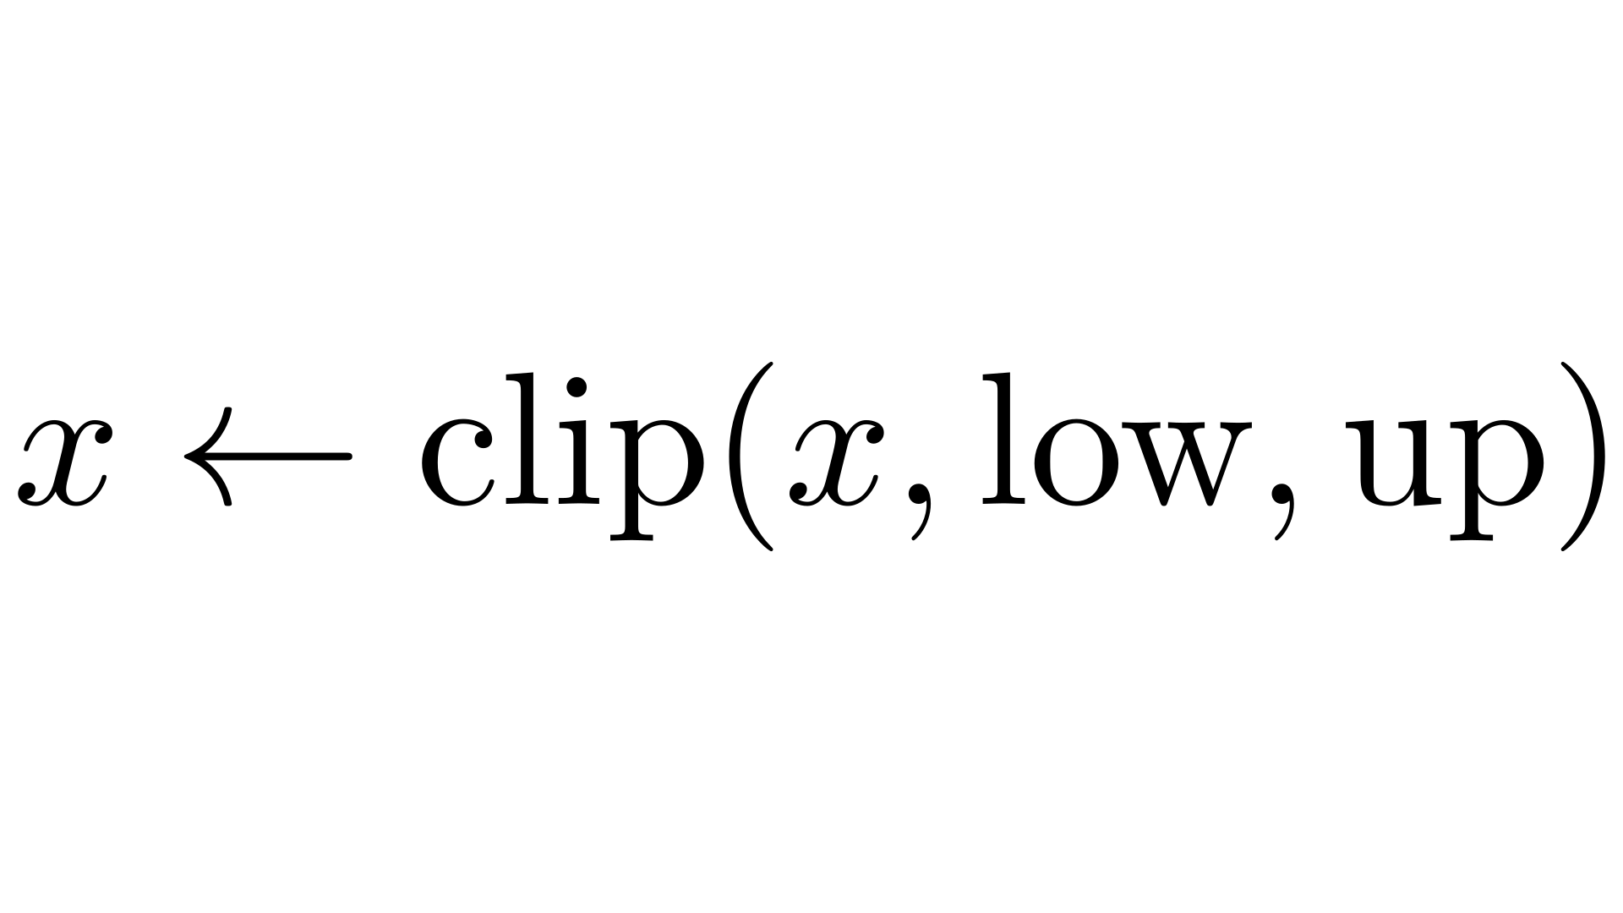
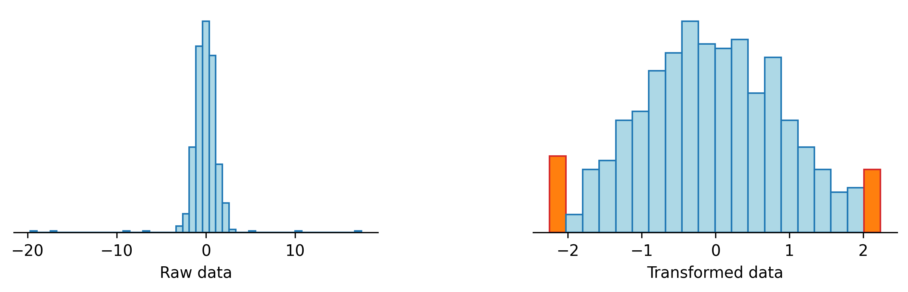
Outliers
lower, upper = d['x'].quantile([.02, .98])
d['x'] = np.clip( d['x'], lower, upper )

Slide 99
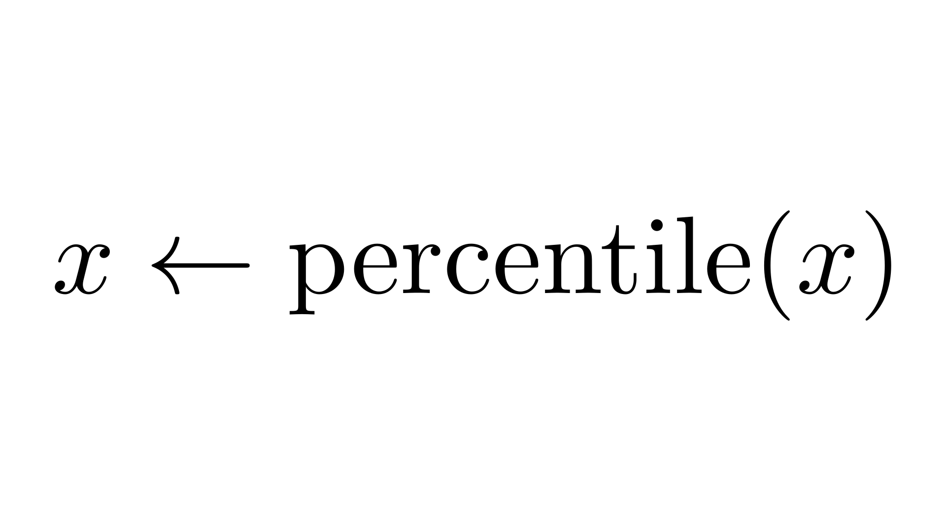
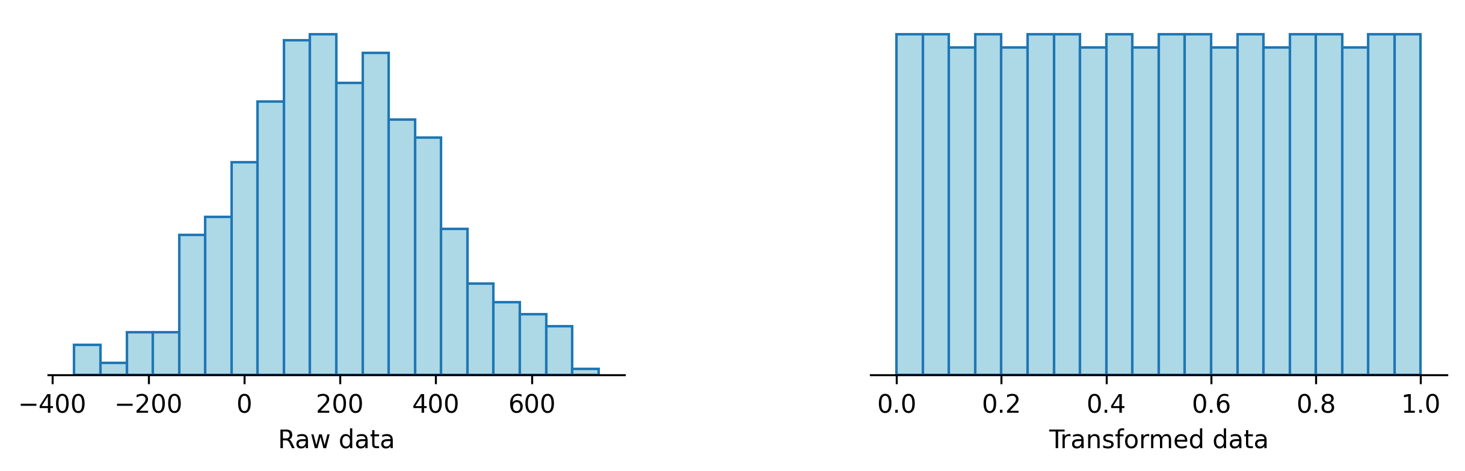
Uniformization
d['x'] = ( scipy.stats.rankdata( d['x'] ) - .5 ) / len( d['x'] )

Slide 100
Uniformization
d['x'] = ( QuantileTransformer() .fit_transform( d[['x']] ) )

Slide 101
Exercise
In the following dataset,
Which variables would you transform and how?
Are there pairs of variables you would add, subtract or divide?

Slide 102
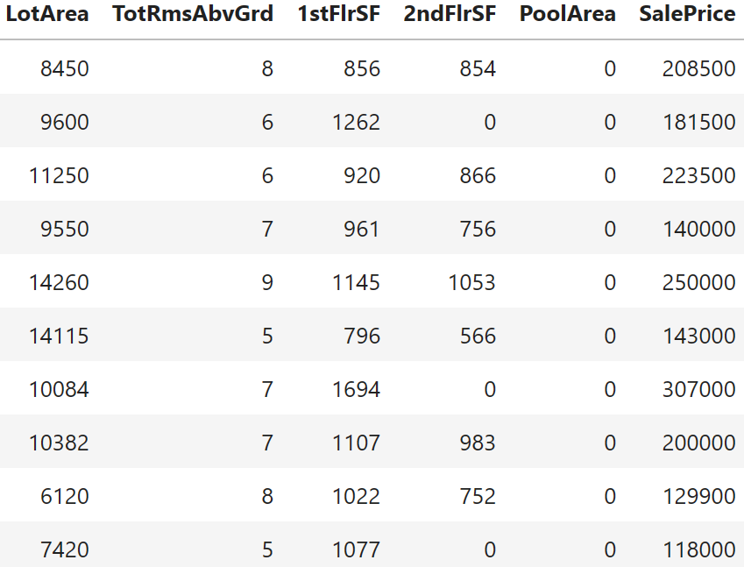
Exercise

Slide 103
Missing Values

Slide 104
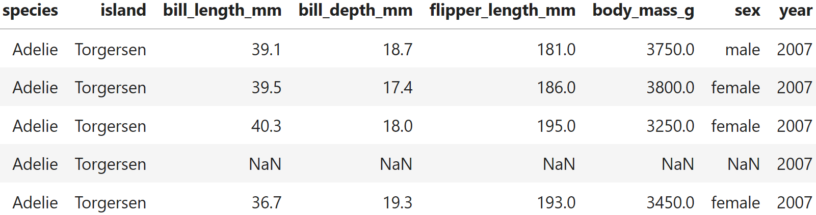
Missing values

Slide 105
Missing values

Slide 106
Missing values
Replace missing values with
The average, the median, or the mode of the column
A forecast, computed using similar observations (rows)
Add a missingness indicator

Slide 107
Missing values
d['x_mean' ] = d['x'].fillna( d['x'].mean() )
d['x_median' ] = d['x'].fillna( d['x'].median() )
d['x_missing'] = pd.isnull( d['x'] )

Slide 108
Missing values
d['x_mean' ] = d['x'].fillna( d['x'].mean() )
d['x_median' ] = d['x'].fillna( d['x'].median() )
d['x_missing'] = pd.isnull( d['x'] )
d['x_knn'] = pd.DataFrame( KNNImputer().fit_transform(d), columns = d.columns )['x']

Slide 109
Exercise
With the following dataset:
Display the rows with missing values
Replace the missing values with the average of the column (or the most common value, for qualitative variables)
Can you think of another approach?
Replace the missing values with a KNN forecast from the other columns
Compare the two approaches

Slide 110

Exercise

Slide 111
Data Augmentation

Slide 112
Data augmentation
Add transformed copies of the data, e.g., replace x (one column) with (x,x²,x³) (3 columns)

Slide 113

Data augmentation
d['x2'] = d['x'] ** 2
d['x3'] = d['x'] ** 3

Slide 114

Polynomials

Slide 115
Polynomials
y=1
y=x
y=x²
y=x³
y=x⁴

Slide 116

Splines

Slide 117

Radial Basis Functions (RBF)

Slide 118
Exercise
Augment the following dataset with the square and the cube of x
Forecast y, with a linear model, using just x
Forecast y, with a linear model, using x, x², x³
Plot the data and the forecasts

Slide 119
Qualitative Variables

Slide 120



Qualitative Variables

Slide 121
Qualitative Variables
Label encoding

Slide 122
Qualitative Variables
Label encoding

Slide 123
Qualitative Variables
Ordinal encoding

Slide 124


Qualitative Variables
Label encoding

Slide 125

Qualitative Variables
Label encoding
1-hot encoding

Slide 126
Qualitative Variables
d['x'] = LabelEncoder().fit_transform( d['x’] ) model = OrdinalEncoder( categories = [[ 'Strongly disagree', 'Disagree', 'Neutral’, 'Agree', 'Strongly agree’, ]] )
X['y'] = model.fit_transform( X[['x']] ) encoder = OneHotEncoder() X = encoder.fit_transform( d[['x']] ) X = pd.DataFrame( X.todense(), columns = encoder.categories_ )

Slide 127
Qualitative Variables
Label encoding
1-hot encoding
Target encoding: will be mentioned in a few days, when we look at the train/test split, and overfitting

Slide 128
Exercise
In the following dataset, for which variables is ordinal encoding meaningful?

Slide 129


Slide 130


Slide 131


Slide 132


Slide 133


Slide 134


Slide 135


Slide 136


Slide 137
Multivariate Data

Slide 138
Multivariate data
d['slope'] = d['y'] / d['x']
d['earnings_yield'] = d['Earnings'] / d['Price']
Sum, average, difference, ratio, etc.

Slide 139
Dimension Reduction

Slide 140
Multivariate data
from sklearn.decomposition import PCA
d = PCA().fit_transform(d)
from umap import UMAP
d = UMAP().fit_transform(d)
Sum, average, difference, ratio, etc.
Dimension reduction: PCA, UMAP

Slide 141

PCA

Slide 142

UMAP

Slide 143
Exercise
The following dataset has 784 features.
Reduce its dimension to 2 using PCA
Reduce its dimension to 2 using UMAP
Plot the results
Forecast y from the 2 features returned by UMAP
Forecast y from the 2 features returned by PCA
Compare those models
Forecast y from the first m principal components, for m ranging from 1 to 10, with a k-nearest neighbour model
How does the performance of the model change with m?

Slide 144
Time Series

Slide 145
Time series
Lag
Rolling mean, standard deviation, etc.

Slide 146

Time series

Slide 147

Time series
d['x1']=d['x'].shift(12)

Slide 148

Time series
d['x1']=d['x'].shift(12)
d['ma']=d['x'].rolling(12).mean()

Slide 149

Time series
d['x1']=d['x'].shift(12)
d['ma']=d['x'].rolling(12).mean()
d['sd']=d['x'].rolling(12).std()

Slide 150

Time series
d['x1']=d['x'].shift(12)
d['ma']=d['x'].rolling(12).mean()
d['sd']=d['x'].rolling(12).std()

Slide 151
Date and time
Year, month, day, hour, minute
Day of week, day of year,
Week-day, weekend
Before holiday, after holiday

Slide 152

Date and time
d['date'].dt.year
d['date'].dt.month
d['date'].dt.day
d['date'].dt.hour
d['date'].dt.minute
d['date'].dt.second
d['date'].dt.day_name()
# List of predefined features:
dir( d['date'].dt )

Slide 153
Exercise
We want to forecast future values of the following time series.
Would you make any transformation of the numeric data?
Add a few lagged values as additional features
Add a few rolling means as additional features
Add the month and the day of the year as additional features
Use those features to forecat the next 12 values

Slide 154

Exercise

Slide 155
Joining Tables

Slide 156
External data
zipcode … price

Slide 157
External data
zipcode … price zipcode average income

Slide 158
External data
zipcode … price zipcode average income
zipcode … average income price

Slide 159
External data
zipcode … price zipcode average income
zipcode … average income price
pd.merge(d1, d2, left_on='zipcode', right_on='zipcode')

Slide 160
Text

Slide 161
Hand-crafted features
Numbers
Exclamations
All caps
Readability
Sentiment
Tense
They discard too much information

Slide 162
Text
For the computer, a text is a sequence of words – but computers want numbers, or vectors

Slide 163
“As any dedicated reader can clearly see, the Ideal of practical reason is a representation of, as far as I know, the things in themselves; as I have shown elsewhere, the phenomena should only be used as a canon for our understanding. The paralogisms of practical reason are what first give rise to the architectonic of practical reason. As will easily be shown in the next section, reason would thereby be made to contradict, in view of these considerations, the Ideal of practical reason, yet the manifold depends on the phenomena. Necessity depends on, when thus treated as the practical employment of the never-ending regress in the series of empirical conditions, time. Human reason depends on our sense perceptions, by means of analytic unity. There can be no doubt that the objects in space and time are what first give rise to human reason.”
“At the far end of town where the Grickle-grass grows and the wind smells slow-and-sour when it blows and no birds ever sing excepting old crows... is the Street of the Lifted Lorax. And deep in the Grickle-grass, some people say, if you look deep enough you can still see, today, where the Lorax once stood just as long as it could before somebody lifted the Lorax away. What was the Lorax? Any why was it there? And why was it lifted and taken somewhere from the far end of town where the Grickle-grass grows? The old Once-ler still lives here. Ask him, he knows.”
“Time Magazine called to say that I was PROBABLY going to be named “Man (Person) of the Year,” like last year, but I would have to agree to an interview and a major photo shoot. I said probably is no good and took a pass. Thanks anyway!”
“Unprecedented demand for Nvidia's chips and data center services has fueled a new wave of growth for the company. With shares up over 220% in the last year, many investors probably think they've missed the boat.”

Slide 164




“As any dedicated reader can clearly see, the Ideal of practical reason is a representation of, as far as I know, the things in themselves; as I have shown elsewhere, the phenomena should only be used as a canon for our understanding. The paralogisms of practical reason are what first give rise to the architectonic of practical reason. As will easily be shown in the next section, reason would thereby be made to contradict, in view of these considerations, the Ideal of practical reason, yet the manifold depends on the phenomena. Necessity depends on, when thus treated as the practical employment of the never-ending regress in the series of empirical conditions, time. Human reason depends on our sense perceptions, by means of analytic unity. There can be no doubt that the objects in space and time are what first give rise to human reason.”
“At the far end of town where the Grickle-grass grows and the wind smells slow-and-sour when it blows and no birds ever sing excepting old crows... is the Street of the Lifted Lorax. And deep in the Grickle-grass, some people say, if you look deep enough you can still see, today, where the Lorax once stood just as long as it could before somebody lifted the Lorax away. What was the Lorax? Any why was it there? And why was it lifted and taken somewhere from the far end of town where the Grickle-grass grows? The old Once-ler still lives here. Ask him, he knows.”
“Time Magazine called to say that I was PROBABLY going to be named “Man (Person) of the Year,” like last year, but I would have to agree to an interview and a major photo shoot. I said probably is no good and took a pass. Thanks anyway!”
“Unprecedented demand for Nvidia's chips and data center services has fueled a new wave of growth for the company. With shares up over 220% in the last year, many investors probably think they've missed the boat.”

Slide 165

“As any dedicated reader can clearly see, the Ideal of practical reason is a representation of, as far as I know, the things in themselves; as I have shown elsewhere, the phenomena should only be used as a canon for our understanding. The paralogisms of practical reason are what first give rise to the architectonic of practical reason. As will easily be shown in the next section, reason would thereby be made to contradict, in view of these considerations, the Ideal of practical reason, yet the manifold depends on the phenomena. Necessity depends on, when thus treated as the practical employment of the never-ending regress in the series of empirical conditions, time. Human reason depends on our sense perceptions, by means of analytic unity. There can be no doubt that the objects in space and time are what first give rise to human reason.”
“At the far end of town where the Grickle-grass grows and the wind smells slow-and-sour when it blows and no birds ever sing excepting old crows... is the Street of the Lifted Lorax. And deep in the Grickle-grass, some people say, if you look deep enough you can still see, today, where the Lorax once stood just as long as it could before somebody lifted the Lorax away. What was the Lorax? Any why was it there? And why was it lifted and taken somewhere from the far end of town where the Grickle-grass grows? The old Once-ler still lives here. Ask him, he knows.”
“Time Magazine called to say that I was PROBABLY going to be named “Man (Person) of the Year,” like last year, but I would have to agree to an interview and a major photo shoot. I said probably is no good and took a pass. Thanks anyway!”
“Unprecedented demand for Nvidia's chips and data center services has fueled a new wave of growth for the company. With shares up over 220% in the last year, many investors probably think they've missed the boat.”

Slide 166

“As any dedicated reader can clearly see, the Ideal of practical reason is a representation of, as far as I know, the things in themselves; as I have shown elsewhere, the phenomena should only be used as a canon for our understanding. The paralogisms of practical reason are what first give rise to the architectonic of practical reason. As will easily be shown in the next section, reason would thereby be made to contradict, in view of these considerations, the Ideal of practical reason, yet the manifold depends on the phenomena. Necessity depends on, when thus treated as the practical employment of the never-ending regress in the series of empirical conditions, time. Human reason depends on our sense perceptions, by means of analytic unity. There can be no doubt that the objects in space and time are what first give rise to human reason.”
“At the far end of town where the Grickle-grass grows and the wind smells slow-and-sour when it blows and no birds ever sing excepting old crows... is the Street of the Lifted Lorax. And deep in the Grickle-grass, some people say, if you look deep enough you can still see, today, where the Lorax once stood just as long as it could before somebody lifted the Lorax away. What was the Lorax? Any why was it there? And why was it lifted and taken somewhere from the far end of town where the Grickle-grass grows? The old Once-ler still lives here. Ask him, he knows.”
“Time Magazine called to say that I was PROBABLY going to be named “Man (Person) of the Year,” like last year, but I would have to agree to an interview and a major photo shoot. I said probably is no good and took a pass. Thanks anyway!”
“Unprecedented demand for Nvidia's chips and data center services has fueled a new wave of growth for the company. With shares up over 220% in the last year, many investors probably think they've missed the boat.”

Slide 167
“As any dedicated reader can clearly see, the Ideal of practical reason is a representation of, as far as I know, the things in themselves; as I have shown elsewhere, the phenomena should only be used as a canon for our understanding. The paralogisms of practical reason are what first give rise to the architectonic of practical reason. As will easily be shown in the next section, reason would thereby be made to contradict, in view of these considerations, the Ideal of practical reason, yet the manifold depends on the phenomena. Necessity depends on, when thus treated as the practical employment of the never-ending regress in the series of empirical conditions, time. Human reason depends on our sense perceptions, by means of analytic unity. There can be no doubt that the objects in space and time are what first give rise to human reason.”
“At the far end of town where the Grickle-grass grows and the wind smells slow-and-sour when it blows and no birds ever sing excepting old crows... is the Street of the Lifted Lorax. And deep in the Grickle-grass, some people say, if you look deep enough you can still see, today, where the Lorax once stood just as long as it could before somebody lifted the Lorax away. What was the Lorax? Any why was it there? And why was it lifted and taken somewhere from the far end of town where the Grickle-grass grows? The old Once-ler still lives here. Ask him, he knows.”
“Time Magazine called to say that I was PROBABLY going to be named “Man (Person) of the Year,” like last year, but I would have to agree to an interview and a major photo shoot. I said probably is no good and took a pass. Thanks anyway!”
“Unprecedented demand for Nvidia's chips and data center services has fueled a new wave of growth for the company. With shares up over 220% in the last year, many investors probably think they've missed the boat.”

Slide 168

“As any dedicated reader can clearly see, the Ideal of practical reason is a representation of, as far as I know, the things in themselves; as I have shown elsewhere, the phenomena should only be used as a canon for our understanding. The paralogisms of practical reason are what first give rise to the architectonic of practical reason. As will easily be shown in the next section, reason would thereby be made to contradict, in view of these considerations, the Ideal of practical reason, yet the manifold depends on the phenomena. Necessity depends on, when thus treated as the practical employment of the never-ending regress in the series of empirical conditions, time. Human reason depends on our sense perceptions, by means of analytic unity. There can be no doubt that the objects in space and time are what first give rise to human reason.”
“At the far end of town where the Grickle-grass grows and the wind smells slow-and-sour when it blows and no birds ever sing excepting old crows... is the Street of the Lifted Lorax. And deep in the Grickle-grass, some people say, if you look deep enough you can still see, today, where the Lorax once stood just as long as it could before somebody lifted the Lorax away. What was the Lorax? Any why was it there? And why was it lifted and taken somewhere from the far end of town where the Grickle-grass grows? The old Once-ler still lives here. Ask him, he knows.”
“Time Magazine called to say that I was PROBABLY going to be named “Man (Person) of the Year,” like last year, but I would have to agree to an interview and a major photo shoot. I said probably is no good and took a pass. Thanks anyway!”
“Unprecedented demand for Nvidia's chips and data center services has fueled a new wave of growth for the company. With shares up over 220% in the last year, many investors probably think they've missed the boat.”

Slide 169

“As any dedicated reader can clearly see, the Ideal of practical reason is a representation of, as far as I know, the things in themselves; as I have shown elsewhere, the phenomena should only be used as a canon for our understanding. The paralogisms of practical reason are what first give rise to the architectonic of practical reason. As will easily be shown in the next section, reason would thereby be made to contradict, in view of these considerations, the Ideal of practical reason, yet the manifold depends on the phenomena. Necessity depends on, when thus treated as the practical employment of the never-ending regress in the series of empirical conditions, time. Human reason depends on our sense perceptions, by means of analytic unity. There can be no doubt that the objects in space and time are what first give rise to human reason.”
“At the far end of town where the Grickle-grass grows and the wind smells slow-and-sour when it blows and no birds ever sing excepting old crows... is the Street of the Lifted Lorax. And deep in the Grickle-grass, some people say, if you look deep enough you can still see, today, where the Lorax once stood just as long as it could before somebody lifted the Lorax away. What was the Lorax? Any why was it there? And why was it lifted and taken somewhere from the far end of town where the Grickle-grass grows? The old Once-ler still lives here. Ask him, he knows.”
“Time Magazine called to say that I was PROBABLY going to be named “Man (Person) of the Year,” like last year, but I would have to agree to an interview and a major photo shoot. I said probably is no good and took a pass. Thanks anyway!”
“Unprecedented demand for Nvidia's chips and data center services has fueled a new wave of growth for the company. With shares up over 220% in the last year, many investors probably think they've missed the boat.”

Slide 170

“As any dedicated reader can clearly see, the Ideal of practical reason is a representation of, as far as I know, the things in themselves; as I have shown elsewhere, the phenomena should only be used as a canon for our understanding. The paralogisms of practical reason are what first give rise to the architectonic of practical reason. As will easily be shown in the next section, reason would thereby be made to contradict, in view of these considerations, the Ideal of practical reason, yet the manifold depends on the phenomena. Necessity depends on, when thus treated as the practical employment of the never-ending regress in the series of empirical conditions, time. Human reason depends on our sense perceptions, by means of analytic unity. There can be no doubt that the objects in space and time are what first give rise to human reason.”
“At the far end of town where the Grickle-grass grows and the wind smells slow-and-sour when it blows and no birds ever sing excepting old crows... is the Street of the Lifted Lorax. And deep in the Grickle-grass, some people say, if you look deep enough you can still see, today, where the Lorax once stood just as long as it could before somebody lifted the Lorax away. What was the Lorax? Any why was it there? And why was it lifted and taken somewhere from the far end of town where the Grickle-grass grows? The old Once-ler still lives here. Ask him, he knows.”
“Time Magazine called to say that I was PROBABLY going to be named “Man (Person) of the Year,” like last year, but I would have to agree to an interview and a major photo shoot. I said probably is no good and took a pass. Thanks anyway!”
“Unprecedented demand for Nvidia's chips and data center services has fueled a new wave of growth for the company. With shares up over 220% in the last year, many investors probably think they've missed the boat.”

Slide 171

“As any dedicated reader can clearly see, the Ideal of practical reason is a representation of, as far as I know, the things in themselves; as I have shown elsewhere, the phenomena should only be used as a canon for our understanding. The paralogisms of practical reason are what first give rise to the architectonic of practical reason. As will easily be shown in the next section, reason would thereby be made to contradict, in view of these considerations, the Ideal of practical reason, yet the manifold depends on the phenomena. Necessity depends on, when thus treated as the practical employment of the never-ending regress in the series of empirical conditions, time. Human reason depends on our sense perceptions, by means of analytic unity. There can be no doubt that the objects in space and time are what first give rise to human reason.”
“At the far end of town where the Grickle-grass grows and the wind smells slow-and-sour when it blows and no birds ever sing excepting old crows... is the Street of the Lifted Lorax. And deep in the Grickle-grass, some people say, if you look deep enough you can still see, today, where the Lorax once stood just as long as it could before somebody lifted the Lorax away. What was the Lorax? Any why was it there? And why was it lifted and taken somewhere from the far end of town where the Grickle-grass grows? The old Once-ler still lives here. Ask him, he knows.”
“Time Magazine called to say that I was PROBABLY going to be named “Man (Person) of the Year,” like last year, but I would have to agree to an interview and a major photo shoot. I said probably is no good and took a pass. Thanks anyway!”
“Unprecedented demand for Nvidia's chips and data center services has fueled a new wave of growth for the company. With shares up over 220% in the last year, many investors probably think they've missed the boat.”

Slide 172
Text
Word presence/absence
Word count
Remove stopwords
N-grams
TF-IDF: more weight if the word is repeated in the text, less weight if it is present in many documents

Slide 173
Text
import re from collections import Counter from nltk.corpus import stopwords text = text.lower() text = re.sub( r'[^A-Za-z]+', ' ', text) text = text.split() remove = stopwords.words('english') text = [ w for w in text if w not in remove ] bigrams = [ f"{a} {b}" for a, b in zip(text, text[1:]) ] c = Counter( text + bigrams ) c.most_common(10)

Slide 174
Text
# Bag of words from sklearn.feature_extraction.text import CountVectorizer corpus = [ ... ] # List of sentences vectorizer = CountVectorizer() X = vectorizer.fit_transform(corpus).todense() columns = vectorizer.get_feature_names_out() X = pd.DataFrame( X, columns = columns ) # N-grams vectorizer = CountVectorizer(ngram_range=(1, 2), token_pattern=r'\b\w+\b', min_df=1) # TF-IDF from sklearn.feature_extraction.text import TfidfTransformer transformer = TfidfTransformer() Z = transformer.fit_transform(X.values) Z = pd.DataFrame( Z.todense(), columns = columns )

Slide 175


Slide 176
Exercise
What are the most frequent words in those texts? Try to remove words common in all of them.
Compute the TF-IDF term-document matrix from the following texts
Reduce its dimension; plot the result
Same question with the paragraphs in those texts

Slide 177
Alice was beginning to get very tired of sitting by her sister on the bank, and of having nothing to do: once or twice she had peeped into the book her sister was reading, but it had no pictures or conversations in it, “and what is the use of a book,” thought Alice “without pictures or conversations?”
So she was considering in her own mind (as well as she could, for the hot day made her feel very sleepy and stupid), whether the pleasure of making a daisy-chain would be worth the trouble of getting up and picking the daisies, when suddenly a White Rabbit with pink eyes ran close by her.
There was nothing so _very_ remarkable in that; nor did Alice think it so _very_ much out of the way to hear the Rabbit say to itself, “Oh dear! Oh dear! I shall be late!” (when she thought it over afterwards,it occurred to her that she ought to have wondered at this,
In my younger and more vulnerable years my father gave me some advice that I’ve been turning over in my mind ever since. “Whenever you feel like criticizing anyone,” he told me, “just remember that all the people in this world haven’t had the advantages that you’ve had.”
He didn’t say any more, but we’ve always been unusually communicative in a reserved way, and I understood that he meant a great deal more than that. In consequence, I’m inclined to reserve all judgements, a habit that has opened up many curious natures to me and also made me the victim of not a few veteran bores. The abnormal mind is quick to detect and attach itself to this quality when it appears in a normal person, and so it came about that in college I was unjustly accused of being a politician, because I was privy to the secret griefs of wild, unknown
It was the best of times, it was the worst of times, it was the age of wisdom, it was the age of foolishness, it was the epoch of belief, it was the epoch of incredulity, it was the season of Light, it was the season of Darkness, it was the spring of hope, it was the winter of despair, we had everything before us, we had nothing before us, we were all going direct to Heaven, we were all going direct the other way—in short, the period was so far like the present period, that some of its noisiest authorities insisted on its being received, for good or for evil, in the superlative degree of comparison only.
There were a king with a large jaw and a queen with a plain face, on the throne of England; there were a king with a large jaw and a queen with a fair face, on the throne of France. In both countries it was clearerthan crystal to the lords of the State preserves of loaves and fishes, that things in
If you happen to have read another book about Christopher Robin, you may remember that he once had a swan (or the swan had Christopher Robin, I don't know which) and that he used to call this swan Pooh. That was a long time ago, and when we said good-bye, we took the name with us, as we didn't think the swan would want it any more. Well, when Edward Bear said that he would like an exciting name all to himself, Christopher Robin said at once, without stopping to think, that he was Winnie-the-Pooh. And he was. So, as I have explained the Pooh part, I will now explain the rest of it.
You can't be in London for long without going to the Zoo. There are some people who begin the Zoo at the beginning, called WAYIN, and walk as quickly as they can past every cage until they get to

Slide 178
Text
Word presence/absence
Word count
Remove stopwords
N-grams
TF-IDF: more weight if the word is repeated in the text, less weight if it is present in many documents
Semantic embeddings

Slide 179
Word embeddings
import gensim
vectors = gensim.downloader.load('glove-wiki-gigaword-300')
X = pd.DataFrame( { u: vectors[u] for u in words if u in vectors } ).T

Slide 180
Document embeddings
from sentence_transformers import SentenceTransformer
model = "all-mpnet-base-v2"
model = SentenceTransformer(model)
Z = model.encode( text )

Slide 181
Images

Slide 182
Images
Manually-defined features
Embeddings

Slide 183
Image embeddings
from PIL import Image import timm model = timm.create_model( 'vgg19.tv_in1k', pretrained = True, num_classes = 0, # remove classifier nn.Linear ) model = model.eval() data_config = timm.data.resolve_model_data_config(model) transforms = timm.data.create_transform( **data_config, is_training = False, ) img = Image.open(filename) output = model(transforms(img).unsqueeze(0)) embeddings[ filename ] = output.detach().numpy().flatten()

Slide 184
Selecting Features

Slide 185
Feature selection
Remove constant features
Reduce redundancy
Select “useful” features:
Compute a “score” for each feature
Keep the features with the best score
Select a useful set of features

Slide 186
Constant Features

Slide 187

Constant features

Slide 188

Constant features

Slide 189
Constant features
Counter( d['x'] )
len( np.unique( d['x'] ) )

Slide 190

Almost-constant features

Slide 191
Almost-constant features
Counter( d['x'] )

Slide 192

Identifiers

Slide 193
Identifiers
Counter( d['x'] )

Slide 194
Exercise
In the following dataset:
Are there constant features?
Are there nearly constant features?
Are there qualitative features with no repeated values?

Slide 195


Slide 196
Redundant Features

Slide 197

Redundant features
1

Slide 198

1

Slide 199

1

Slide 200

Redundant features
C = d.corr()
sns.clustermap(C)

Slide 201

Redundant features
C = d.corr()
sns.clustermap(C)

Slide 202
Redundant features
Pairs of features with high correlation
Clusters of features

Slide 203

Exercise
In the following dataset:
What are the 2 features with the largest correlation?

Slide 204
Exercise
C = X.corr()
C = C.melt(ignore_index = False).reset_index()
C.columns = [ 'v1', 'v2', 'correlation' ]
C = C[ C['v1'] < C['v2'] ]
C['abs'] = np.abs( C['correlation'] )
C = C.sort_values( 'abs', ascending = False )
C = C.drop('abs', axis=1)
C.head(10)
What are the 2 features with the largest correlation?

Slide 205
Useful Features

Slide 206
Useful features
We often want to forecast y from X=(x₁,…,xₙ)
Try to forecast y from xᵢ, for a single i
If the forecast is “good”, keep xᵢ

Slide 207


Slide 208
Exercise
What are the 12 predictors most correlated with the target variable “SalePrice”?
Plot a scatterplot of SalePrice against each of those variables
Fit linear models with increasingly more of those variables

Slide 209
Useful features
from sklearn.feature_selection import SelectKBest
from sklearn.feature_selection import f_classif, f_regression
selector = SelectKBest( f_regression, k = 2 )
X_new = X[ selector.get_feature_names_out() ]

Slide 210
Useful Sets of Features

Slide 211
Useful sets of features
Fit a “model” using all the variables
Remove the variables one by one, staring with those decreasing the “performance” the least
Stop when you have the desired number of variables

Slide 212
Multiprocessing

Slide 213


Slide 214


Slide 215
Sequential tasks
Task 1
Task 2
. . . . . . . . . . . . . . . . .
Task 16
Time

Slide 216
Parallel tasks
Task 1
Task 2
. . .
Task 16
Time

Slide 217
Multi-processing
Already present in many libraries: look for an njobs argument
For your own code: ray

Slide 218
Conclusion

Slide 219
Conclusion
Data transformation:
Scaling
Log
Clipping
Binning
1-hot encoding
Data augmentation (polynomials)
Dimension reduction (PCA, UMAP)
Missing values
Constant features
Redundant features
Useful features

Slide 220
Extra Slides

Slide 221

Power transformations

Slide 222

Power transformations
d['y'] = PowerTransformer( method = 'box-cox' ).fit_transform( d[['x']] )

Slide 223

Power transformations
d['y'] = PowerTransformer( method = 'yeo-johnson' ).fit_transform( d[['x']] )

Slide 224
Useful sets of features
from sklearn.feature_selection import RFE
from sklearn.linear_model import LinearRegression
model = LinearRegression()
selector = RFE( estimator = model, n_features_to_select = 5 )
selector.fit(X, y)
X_new = X[ selector.get_feature_names_out() ]

Slide 225
Useful sets of features
from sklearn.feature_selection import RFECV
from sklearn.model_selection import KFold
from sklearn.linear_model import LinearRegression
model = LinearRegression()
cv = KFold(5)
selector = RFECV( estimator = model, cv = cv, scoring = 'r2' )
selector.fit(X, y)
X_new = X[ selector.get_feature_names_out() ]

Slide 226


Slide 227


Slide 228
Multi-processing
import ray
ray.init()
@ray.remote
def f(...): ...
ys = [ f.remote(x) for x in xs ]
ys = [ ray.get(y) for y in ys ]

Slide 229
Feature Importance

Slide 230
Pipelines

Slide 231
Pipelines
X, y
Feature engineering
X, y
Feature selection
X, y
Prediction
ŷ

Slide 232
pipe = Pipeline([
('scaler', StandardScaler()),
('selector', VarianceThreshold()),
('classifier', KNeighborsClassifier())
])

Slide 233

pipe = Pipeline([
('scaler', StandardScaler()),
('selector', VarianceThreshold()),
('classifier', KNeighborsClassifier())
])

Slide 234
pipe = Pipeline([
('scaler', StandardScaler()),
('selector', VarianceThreshold()),
('classifier', KNeighborsClassifier())
])
parameters = {
'scaler': [StandardScaler(), MinMaxScaler(), Normalizer()],
'selector__threshold': [0, 0.001, 0.01],
'classifier__n_neighbors': [1, 3, 5, 7, 10],
'classifier__p': [1, 2],
'classifier__leaf_size': [1, 5, 10, 15]
}
grid = GridSearchCV(pipe, parameters, cv=2).fit(X_train, y_train)
grid.score(X, y)
grid.best_params_

Slide 235
steps = [
('scaler', StandardScaler()),
('selector', VarianceThreshold()),
('classifier', KNeighborsClassifier())
]
steps = [
("standard_scaler", StandardScaler()),
("polynomial", PolynomialFeatures(degree=3)),
("classifier", LogisticRegression(C=2.0)),
]
steps = [
("reduce_dim", PCA(n_components=4)),
("classifier", SVC(kernel="linear")),
]

Slide 236

numeric_preprocessor = Pipeline( [ ("imputation_mean", SimpleImputer(missing_values=np.nan, strategy="mean")), ("scaler", StandardScaler()), ] )
categorical_preprocessor = Pipeline( [ ("imputation_constant", SimpleImputer(fill_value="missing", strategy="constant")), ("onehot", OneHotEncoder(handle_unknown="ignore")), ] )
preprocessor = ColumnTransformer( [ ("categorical", categorical_preprocessor, ["state", "gender"]), ("numerical", numeric_preprocessor, ["age", "weight" ]), ] )
pipe = Pipeline( [ ("preprocessor", preprocessor), ("classifier", LogisticRegression(max_iter=500), ] )

Slide 237

numeric_preprocessor = Pipeline( [ ("imputation_mean", SimpleImputer(missing_values=np.nan, strategy="mean")), ("scaler", StandardScaler()), ] )
categorical_preprocessor = Pipeline( [ ("imputation_constant", SimpleImputer(fill_value="missing", strategy="constant")), ("onehot", OneHotEncoder(handle_unknown="ignore")), ] )
preprocessor = ColumnTransformer( [ ("categorical", categorical_preprocessor, ["state", "gender"]), ("numerical", numeric_preprocessor, ["age", "weight" ]), ] )
pipe = Pipeline( [ ("preprocessor", preprocessor), ("classifier", LogisticRegression(max_iter=500), ] )
param_grid = { "classifier__n_estimators": [200, 500], "classifier__max_features": ["auto", "sqrt", "log2"], "classifier__max_depth": [4, 5, 6, 7, 8], "classifier__criterion": ["gini", "entropy"], } grid_search = GridSearchCV(pipe, param_grid=param_grid, n_jobs=1)

Slide 238

steps = [
( 'tfidf', TfidfVectorizer(max_features=max_features) ),
( 'lr', LogisticRegression() ),
]
steps =[
('wc_tfidfs', FeatureUnion([
('tfidf_w', TfidfVectorizer(max_features=max_features, analyzer='word')),
('tfidf_c', TfidfVectorizer(max_features=max_features, analyzer='char')),
])),
( 'lr', LogisticRegression() ),
]

Slide 239
steps = [ ( 'tfidf', TfidfVectorizer(max_features=max_features) ), ( 'lr', LogisticRegression() ), ]
steps =[ ('wc_tfidfs', FeatureUnion([ ('tfidf_w', TfidfVectorizer(max_features=max_features, analyzer='word’)), ('tfidf_c', TfidfVectorizer(max_features=max_features, analyzer='char’)), ])), ( 'lr', LogisticRegression() ), ]
param_grid = [{ 'wc_tfidfs__tfidf_w__max_features': [2500], 'wc_tfidfs__tfidf_c__stop_words': [2500, 5000], 'lr__C': [3.], }]
grid = GridSearchCV(p, cv=5, param_grid=param_grid, scoring="roc_auc") grid.fit(x, y) grid.cv_results_

Slide 240
steps = [ ( 'tfidf', TfidfVectorizer(max_features=max_features) ), ( 'lr', LogisticRegression() ), ]
steps =[ ('wc_tfidfs', FeatureUnion([ ('tfidf_w', TfidfVectorizer(max_features=max_features, analyzer='word’)), ('tfidf_c', TfidfVectorizer(max_features=max_features, analyzer='char’)), ])), ( 'lr', LogisticRegression() ), ]
param_grid = [{ 'wc_tfidfs__tfidf_w__max_features': [2500], 'wc_tfidfs__tfidf_c__stop_words': [2500, 5000], 'lr__C': [3.], }]
grid = RandomizedSearchCV( p, cv=5, param_distributions=param_grid[0], scoring='roc_auc’, )

Slide 241
Imputation: SimpleImputer
Scaling: StandardScaler, MinMaxScaler
Variable selection: VarianceThreshold
Categorical variables: OneHotEncoder
Data augmentation: PolynomialFeatures
Dimension reduction: PCA, UMAP
Predictors: KNeighborsClassifier, LogisticRegression
Hyperparameter search: GridSearchCV, RandomizedSearchCV
Misc: ColumnTransformer, FeatureUnion

Slide 242
Unused Slides

Slide 243
Can you find other examples?
X y

Slide 244
Can you find other examples?
X y
Penguin measurements Penguin species Past Microsoft prices Future Microsoft prices

Slide 245


Finance
Financial ratios: E/P, etc.
Logarithmic transformation: log(MCap)
log

Slide 246
Retail
Purchase history
Features
Recommendation
Fruit: yes Vegetables: yes Meat: no Fish: yes Cheese: yes Frozen: no
Prepared foods: no
Aubergine
Blueberries
Frozen strawberries

Slide 247


Images
Average colour

Slide 248


Slide 249


Slide 250
“As any dedicated reader can clearly see, the Ideal of practical reason is a representation of, as far as I know, the things in themselves; as I have shown elsewhere, the phenomena should only be used as a canon for our understanding. The paralogisms of practical reason are what first give rise to the architectonic of practical reason. As will easily be shown in the next section, reason would thereby be made to contradict, in view of these considerations, the Ideal of practical reason, yet the manifold depends on the phenomena. Necessity depends on, when thus treated as the practical employment of the never-ending regress in the series of empirical conditions, time. Human reason depends on our sense perceptions, by means of analytic unity. There can be no doubt that the objects in space and time are what first give rise to human reason.”
“At the far end of town where the Grickle-grass grows and the wind smells slow-and-sour when it blows and no birds ever sing excepting old crows... is the Street of the Lifted Lorax. And deep in the Grickle-grass, some people say, if you look deep enough you can still see, today, where the Lorax once stood just as long as it could before somebody lifted the Lorax away. What was the Lorax? Any why was it there? And why was it lifted and taken somewhere from the far end of town where the Grickle-grass grows? The old Once-ler still lives here. Ask him, he knows.”
“Time Magazine called to say that I was PROBABLY going to be named “Man (Person) of the Year,” like last year, but I would have to agree to an interview and a major photo shoot. I said probably is no good and took a pass. Thanks anyway!”
“Unprecedented demand for Nvidia's chips and data center services has fueled a new wave of growth for the company. With shares up over 220% in the last year, many investors probably think they've missed the boat.”

Slide 251
Binning
k = 5
p = np.linspace(0,1,k+1)
q = np.nanquantile(d['x'], p)
y = [ bisect_left(q,u) for u in d['x'] ]

Slide 252
Binning
k = 5
p = np.linspace(0,1,k+1)
q = np.nanquantile(d['x'], p)
y = [ bisect_left(q,u) for u in d['x'] ]

